Slide 2

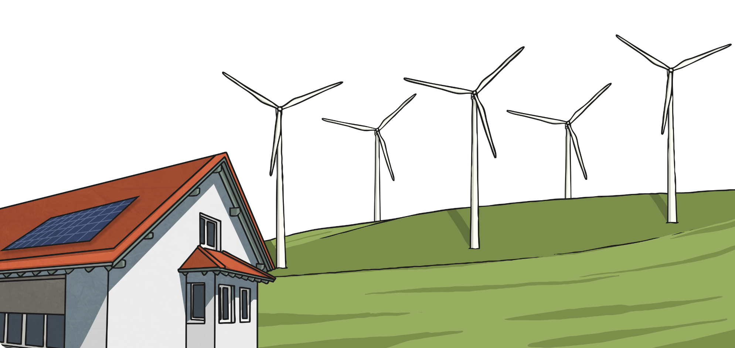
Renewable Energy
What is renewable energy?
Renewable energy comes from natural resources that are
naturally replenished, such as sunlight, wind, and waves.

Slide 3

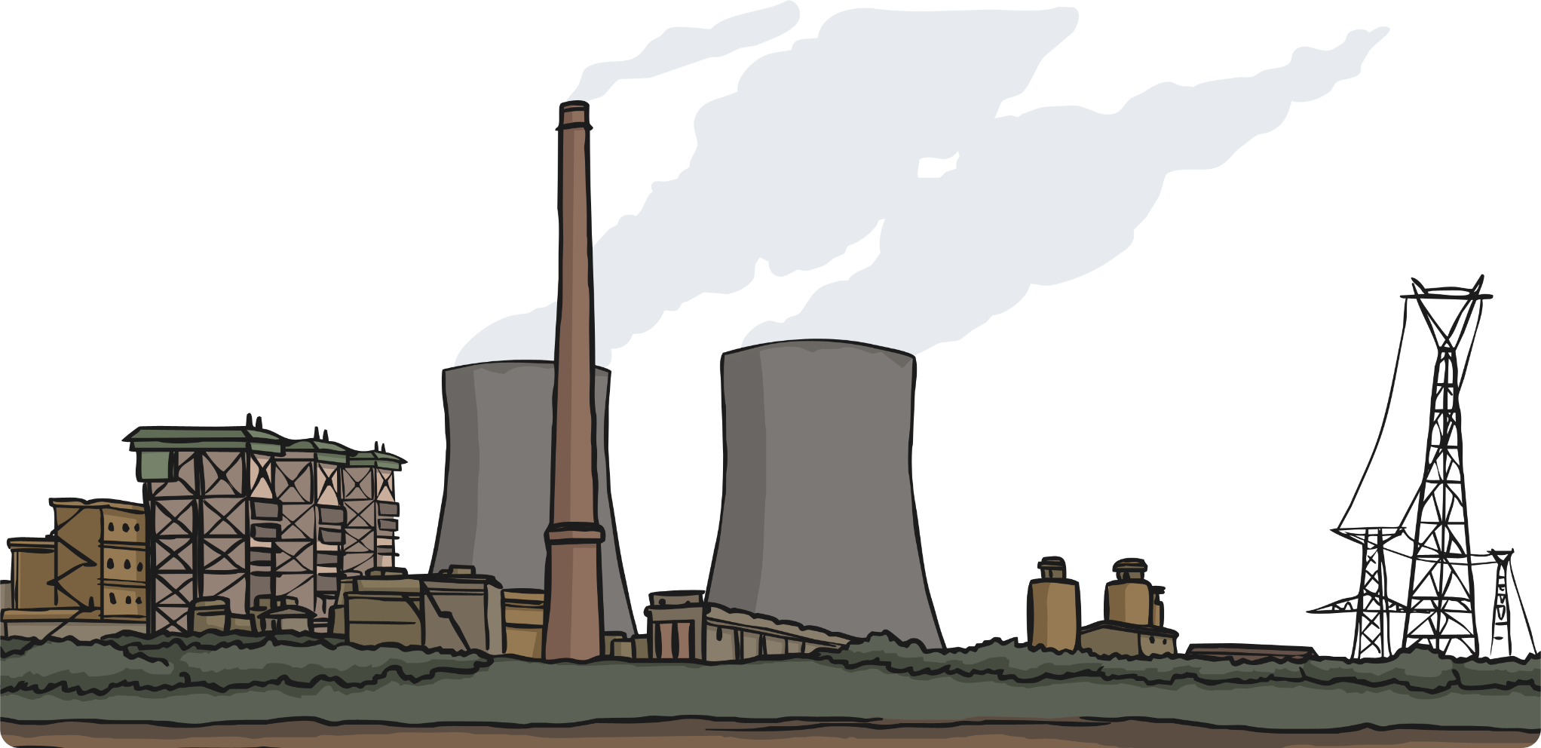
Non-Renewable Energy
What is non-renewable energy?
Non-renewable energy comes from natural resources that are
not naturally replenished, such as coal, oil, and natural gas.

Slide 4
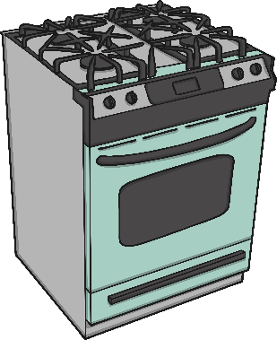
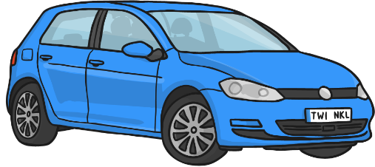

What Do We Use Energy For?
Gas is used to heat our homes, water, and to cook our food.
We need energy to power our cars. We use diesel, oil, or electricity for fuel.
We use electricity to power lots of things, such as lights, televisions, and computers.

Slide 5
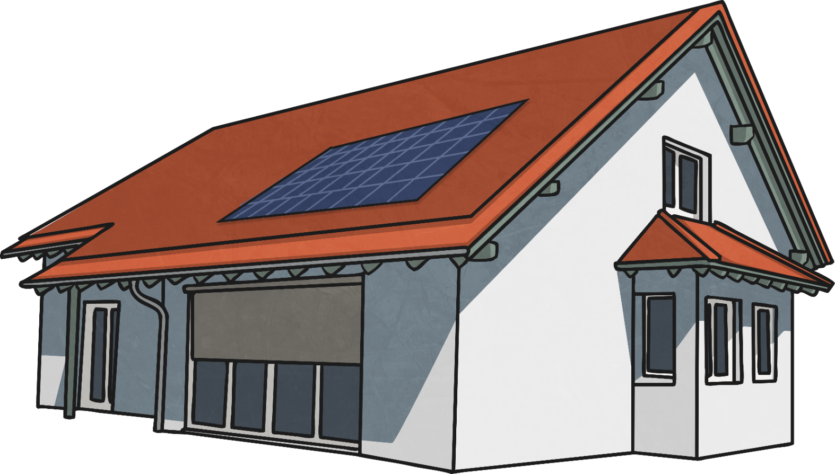
Solar Energy
Solar energy comes from the sun.
The sun can be used to give us heat energy.
Solar panels are used to convert sunlight into electricity.

Slide 6
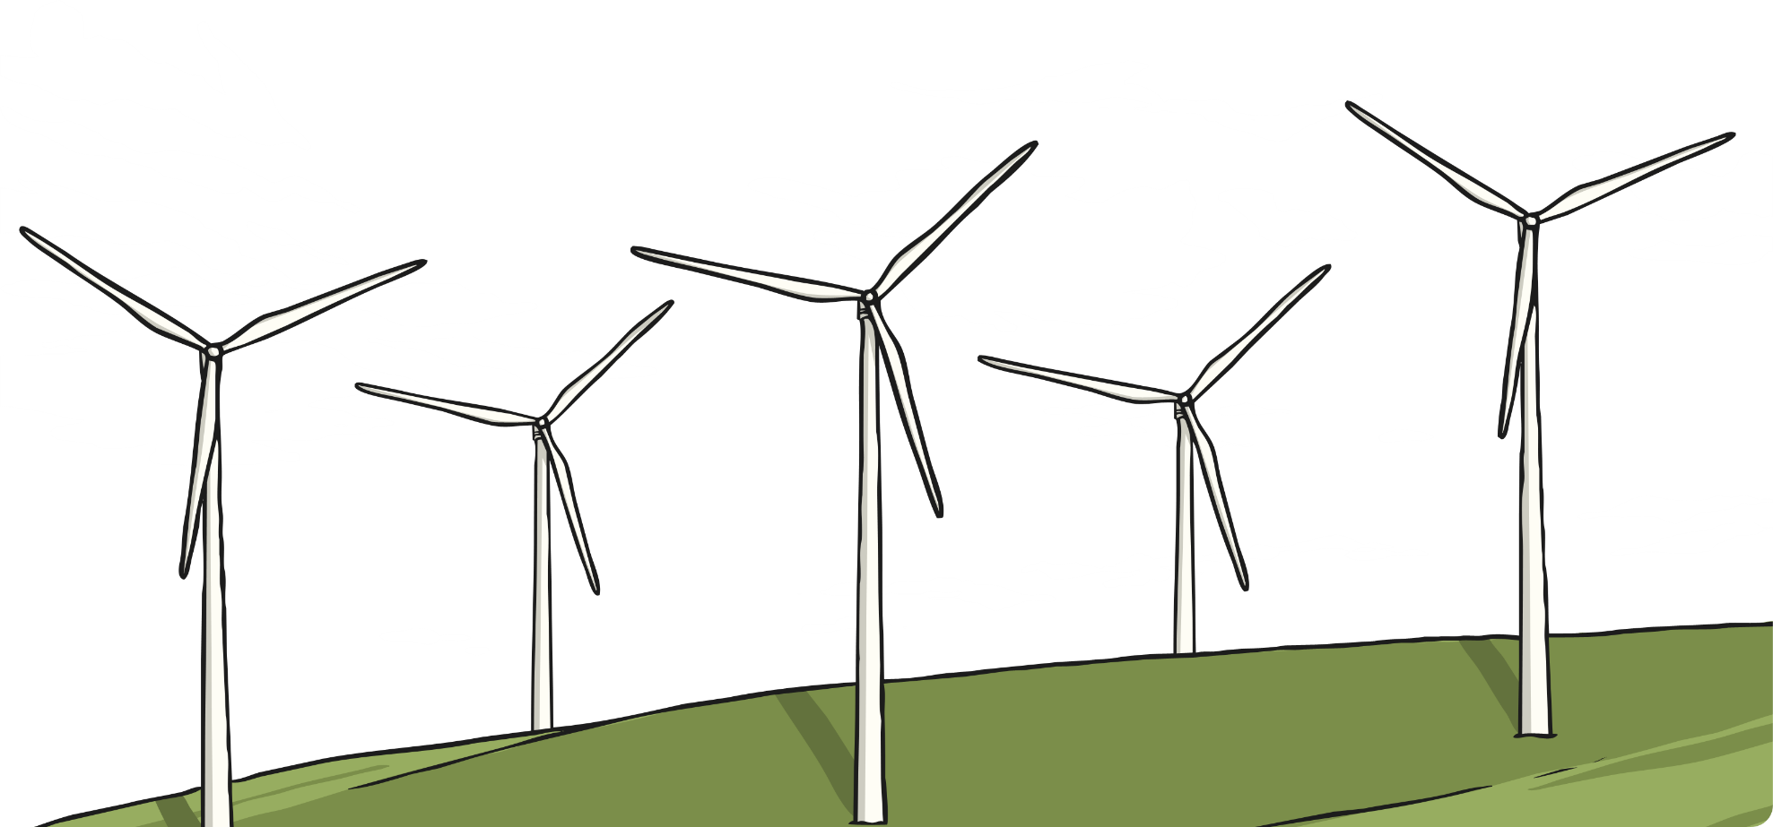
Wind Energy
Wind turbines are used to convert wind energy to electricity.
The wind blows the blades around and this movement is converted into electricity.
A group of wind turbines is called a wind farm.

Slide 7
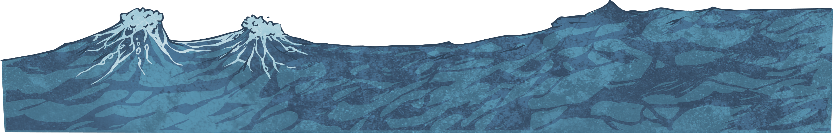
Hydropower Energy
Hydropower is energy that comes from moving water.
Water that flows down fast-flowing rivers is used to spin turbines in dams that generate electricity.
The movement of big waves at sea can also be used to generate energy.

Slide 8

Geothermal Energy
Geothermal energy is heat from under the Earth’s surface.
Geothermal energy can be collected from hot water just below the Earth’s surface, or hot magma deep below the surface.
A geothermal power plant is used to convert the heat from under the Earth’s surface to usable energy.

Slide 9
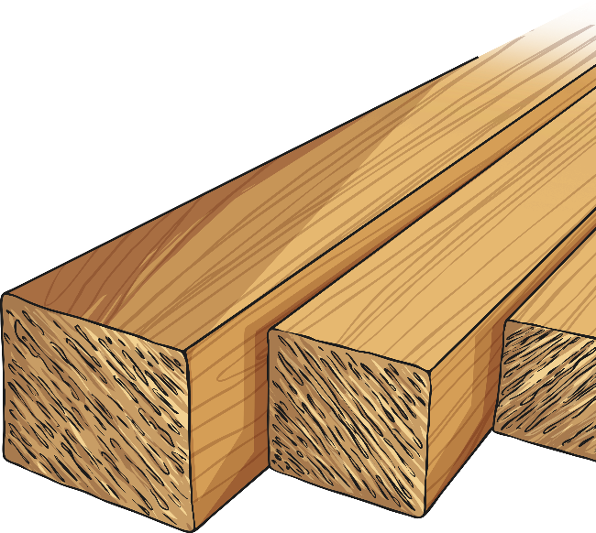
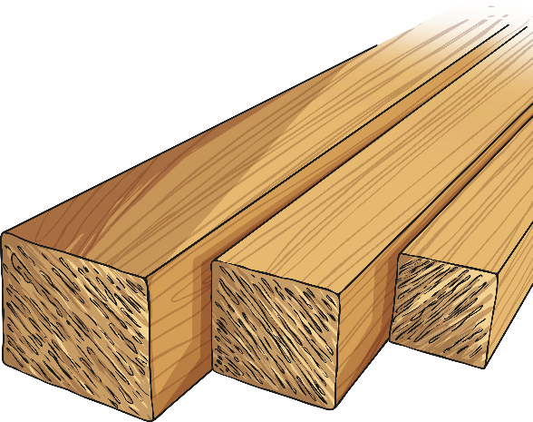

Biomass Energy
Biomass means “natural material.” Energy can be obtained by burning natural waste materials such as scrap pieces of wood, dead trees, and unused parts of crops.
Biomass is used to create biofuels.

Slide 10
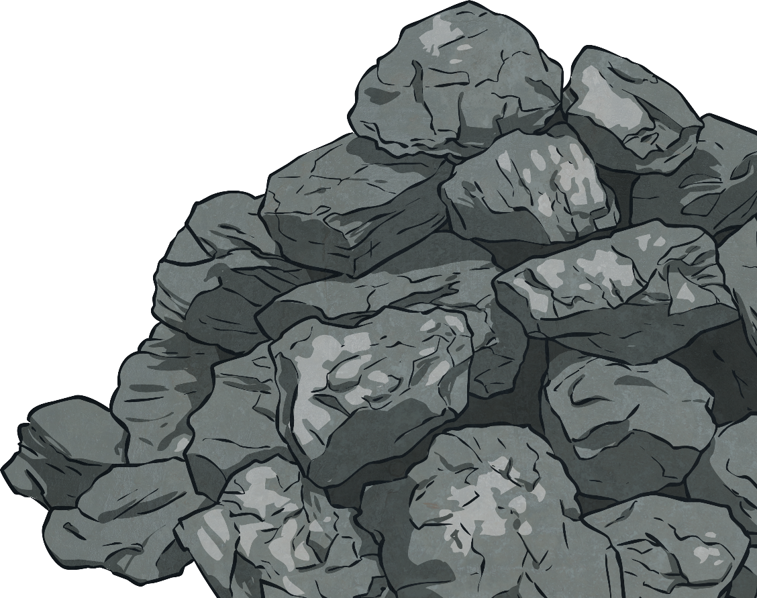
Coal Energy
Coal is mined from under the ground and burned in large power
stations to produce electricity.
The coal that we use cannot be replaced, so one day there will be no coal left.
Burning coal is bad for the environment because lots of carbon dioxide gets released into the atmosphere.

Slide 11
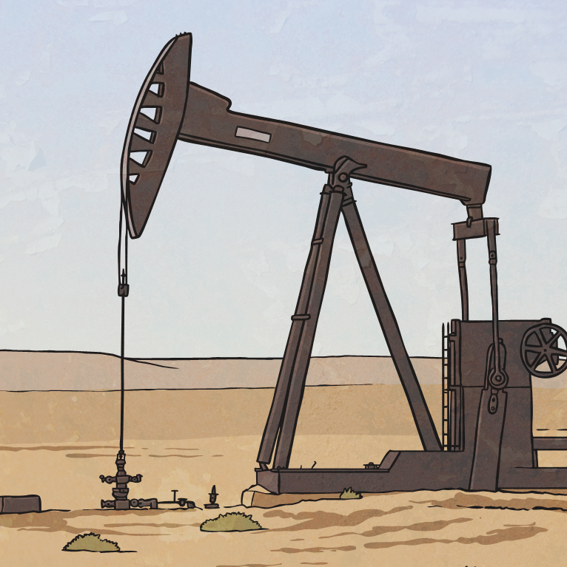
Oil Energy
Oil is found deep underground and
pumped up to the surface for
us to use.
Oil is burned at some power stations to make electricity and
is also used to make fuel which
we use in our cars.
If we keep using oil, there will
eventually be none left.

Slide 12
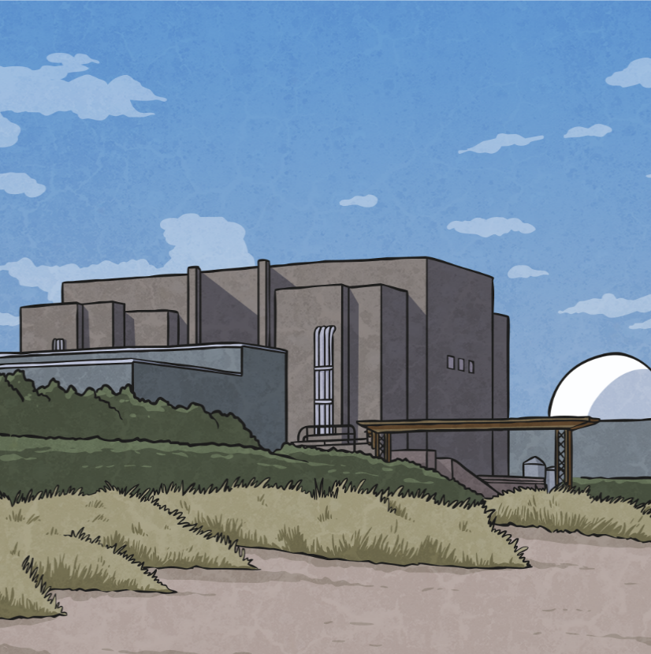
Nuclear Energy
Nuclear power stations use uranium as fuel to make electricity. Uranium is a natural resource taken from the ground so it is not renewable.
Nuclear power doesn’t produce much waste, so it is a very clean way of generating energy.

Slide 13
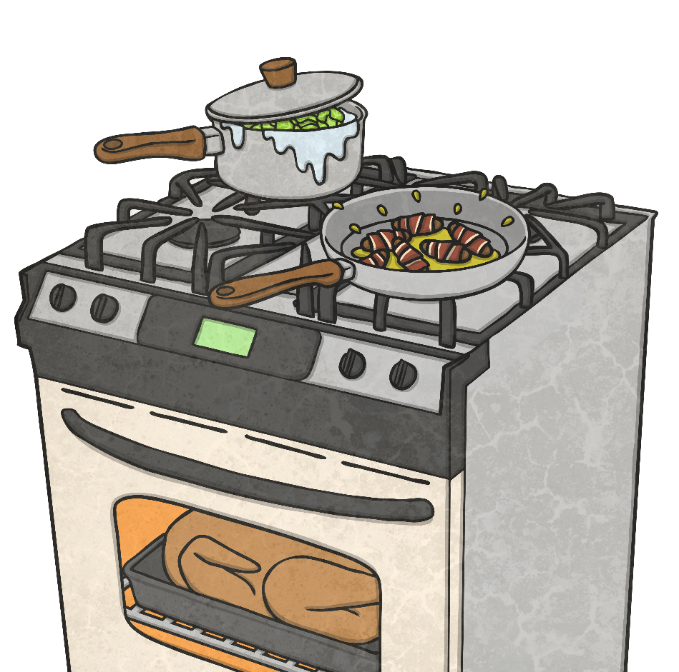
Gas Energy
Natural gas is found deep underground and is pumped into our homes. We use it to cook and burn it in a boiler to heat
our water.
The gas that we pump from underground will one day run out and there won’t be any left to use.

Slide 14


Why Don’t We Use Renewable
Energy All the Time?
Renewable energy, such as wind or sunshine, can’t be stored to be used whenever we need it.
If the wind doesn’t blow, or if it isn’t very sunny, then there may not be enough power for everyone.
Non-renewable resources, such as oil or coal,
can be stored and used when they are needed.
Non-renewable energy is usually cheaper than
renewable energy, which means not everyone
can afford to use renewable energy.

