Slide 1
25 Funny and Weird Sports You've Never Heard of
The information has been copied from the website - https://www.ba-bamail.com/content.aspx?emailid=15239 to control the content that pupils are accessing.

Slide 2
Unusual sports
On the following slides you will find out about some very unusual sports.
Do not try any of these activities at home, without very clear support from your parent/carer. To truly understand why - write a list/discuss what organisers would have to think about to keep spectators and players safe.
Draw your own world map and try to plot where the sports come from.
Diamond rank which sports you would like to take part in or watch.

Slide 3
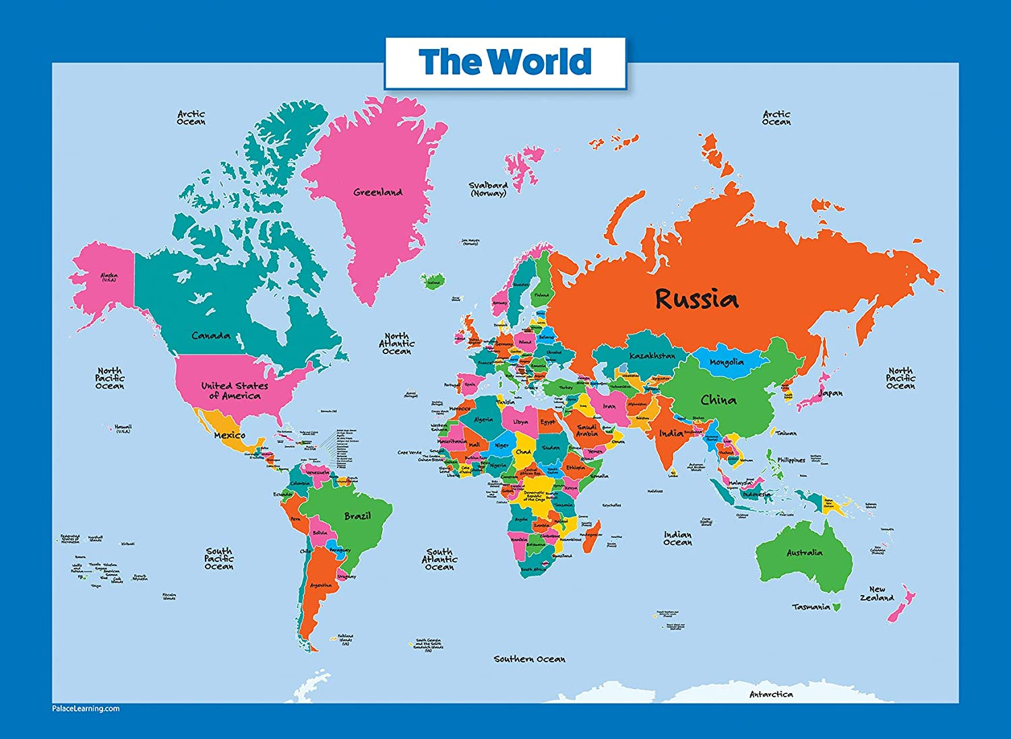
Here is a map you can try to copy.
Remember it doesn’t have to be perfect, just represent the basic shapes.

Slide 4
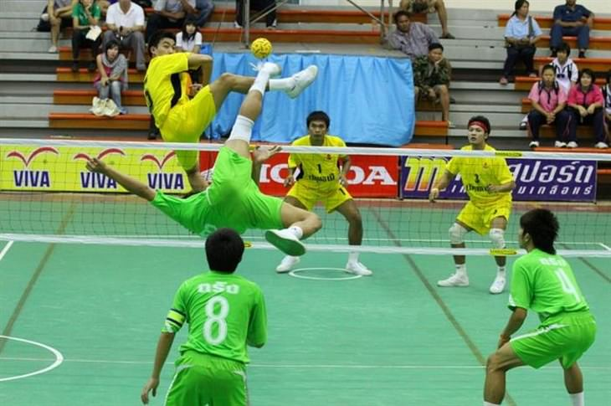
1. Sepak Takraw
A popular sport in Southeast Asia, this action-packed game resembles volleyball but instead of hands, players use their feet, knees, chest, and head to move the ball around, which is made from softwood. The International Sepak Takraw Federation holds competitions with teams from over a hundred different countries.

Slide 5
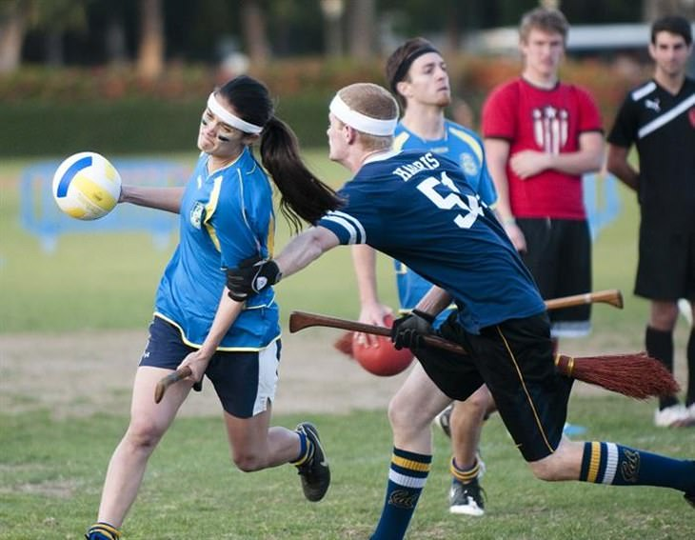
2. Quidditch
This sport was first described in the popular Harry Potter book series, which is meant to be played on flying broomsticks. Real-world enthusiasts have invented a land version that is played on a hockey field. The game first began in US colleges and has since spread across the states. Supporters refer to the game as a muggle quidditch because muggles are what the series characters call non-magic folk.

Slide 6
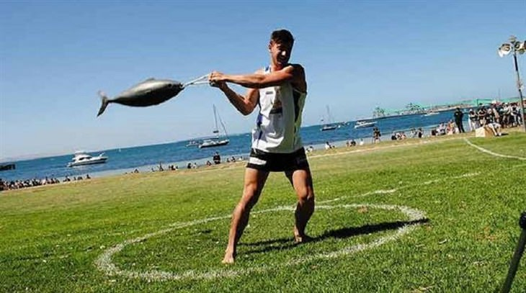
3. Tuna Tossing
This sport began in South Australia in the small fishing community of Port Lincoln. It was inspired by the local fishermen who would toss fish onto their trucks with force and started being used as a way to spice up a local festival. The winner is the person who manages to throw a 20-pound fish the furthest. Nowadays the competition has become somewhat cleaner: participants use rubber fish instead.

Slide 7
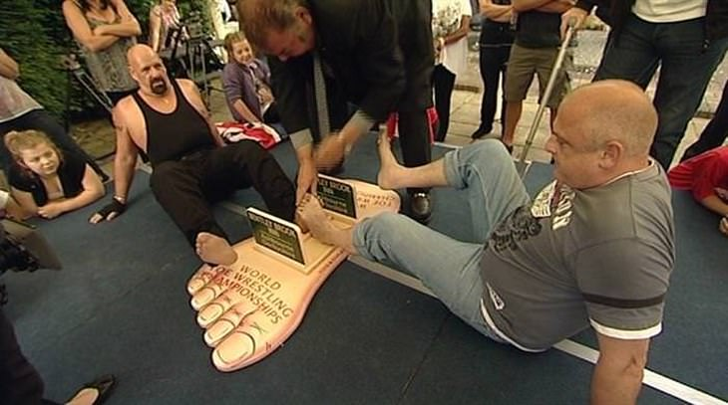
4. Toe wrestling
This sport is similar to arm wrestling with players attempting to pin down their opponent's toes for three seconds. Players play with their bare feet alternating between their left and right feet and play the best of three rounds. There are separate divisions for men and women. The World Toe Wrestling Championship has been ongoing since the 1970’s and enjoys growing participation.

Slide 8
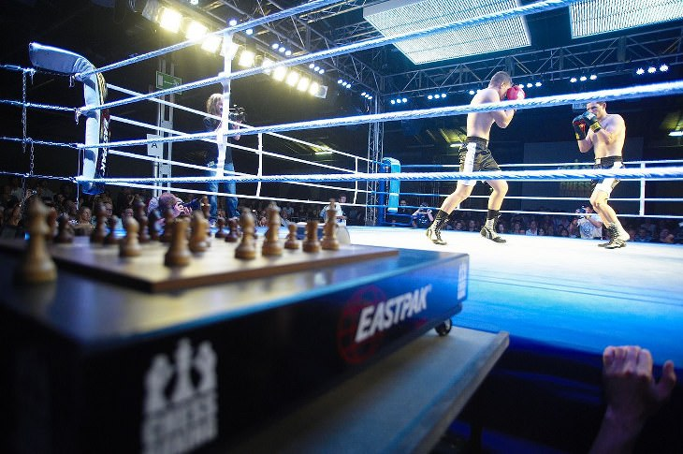
5. Chess boxing
This unlikely combination of sports involves brains and brawn. Competitors play 11 alternating rounds of chess and boxing for three minutes each. This little-known sport has fans in Germany, India, Russia, and the UK.

Slide 9
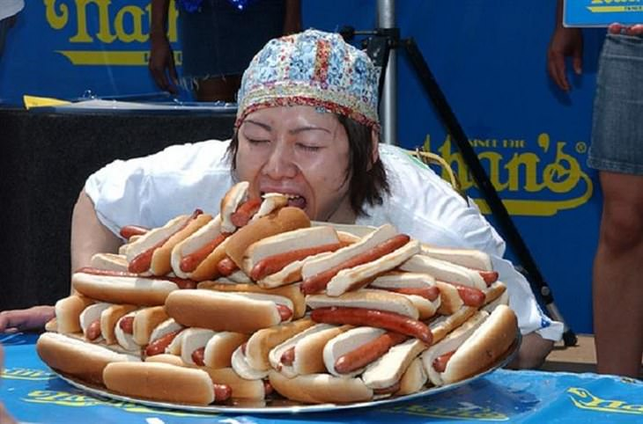
6. Hotdog Eating Contests
One of the more prominent forms of competitive eating, the rules involve participants trying to eat as many hot dogs as they can in a ten minute period. The sport began in US county fairs and has gained recognition due to Nathan’s Hotdog Eating Contest, held annually on the 4th of July. The sport has spawned a huge industry and enjoys popularity in the US, Canada, and Japan.

Slide 10
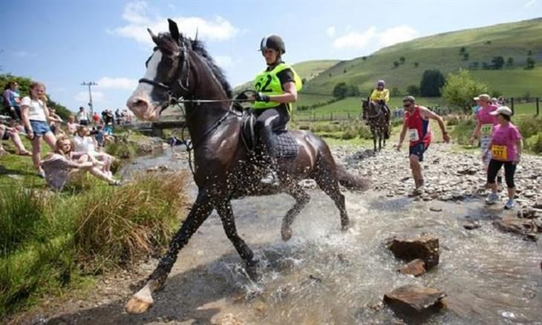
7. Man vs. Horse Marathon
This marathon began as a way to settle a pub argument in 1979 when Welsh locals Gordon Green and Glyn Hones wondered who would win a marathon - a horse or a man. Ever since then, an annual 22-mile (35.4 km) marathon is held in Welsh Town, Wales with both men and horses running. Men have won on two occasions, but it is usually the horses that emerge as victors. If a human wins, they are eligible to win a £25,000 cash prize.

Slide 11
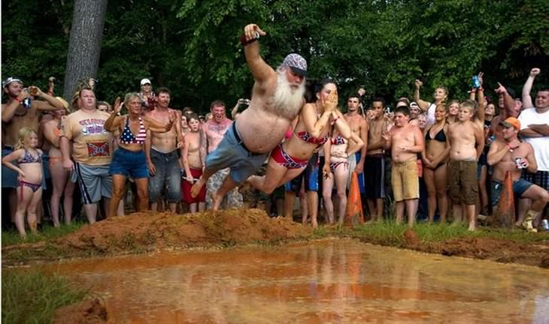
8. Redneck Games
Held in East Dublin, Georgia every summer since 1996, this athletic event involves unique sports you might not usually see in any other sporting context. Some of the events include toilet seat tossing, seed spitting, mud belly flops, armpit serenades, and dumpster diving.

Slide 12
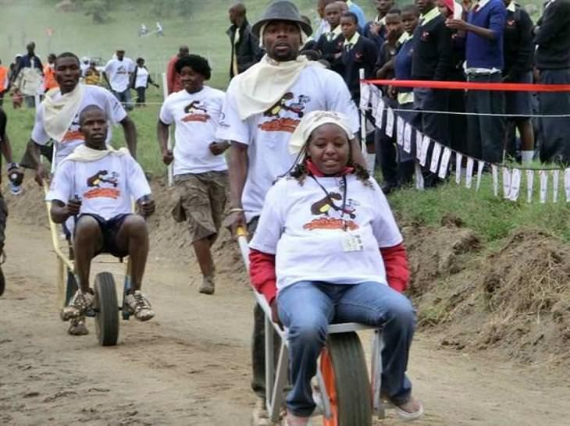
9. Wheelbarrow Racing
In Kenya, there is a race called “To Hell’s Gate on a Wheelbarrow”, which is named after the national park that holds the 5-kilometer (3.1-mile) racecourse. Funds raised from this fun event go to conservation efforts for the park.

Slide 13
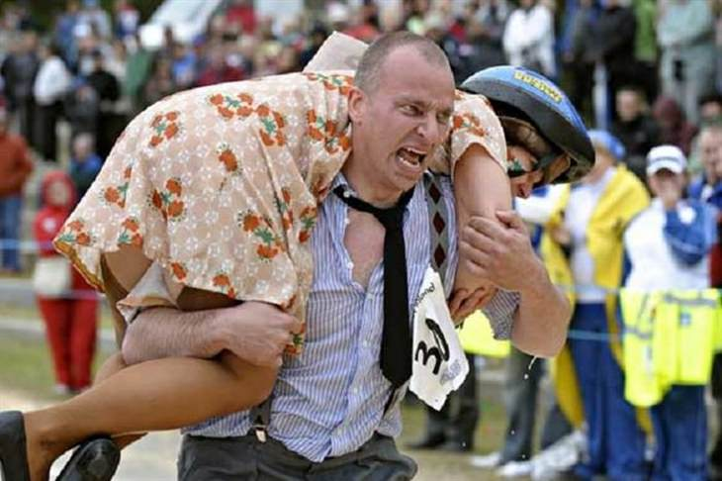
10. Wife Carrying
While this activity sounds like it could be a race held in a quaint European town, this sport enjoys global appeal. The game has its origins in Finland where local women were commonly abducted. The World Wife Carrying World Championship has teams competing from Australia, Germany, Great Britain, Estonia, Ireland, and the United States. The United States team is highly competitive: participants need to win their state championship to qualify for the global championship. Despite the title, any team of two can participate.

Slide 14
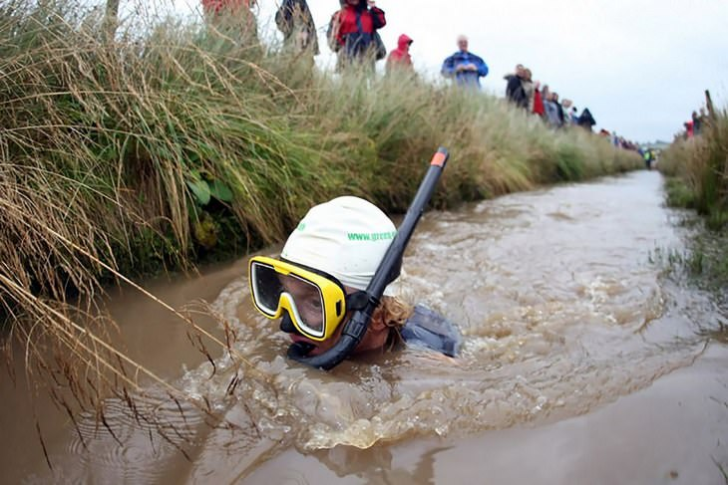
11. Bog Snorkeling
Every August, over a hundred swimmers from across the globe meet up in the Welsh town of Llanwrtyd Wells to take part in the annual World Bog Snorkeling Championships. All participants need to wear flippers and snorkels, and have to complete two lengths of the 60-yard trench without using any traditional swimming strokes whatsoever!

Slide 15
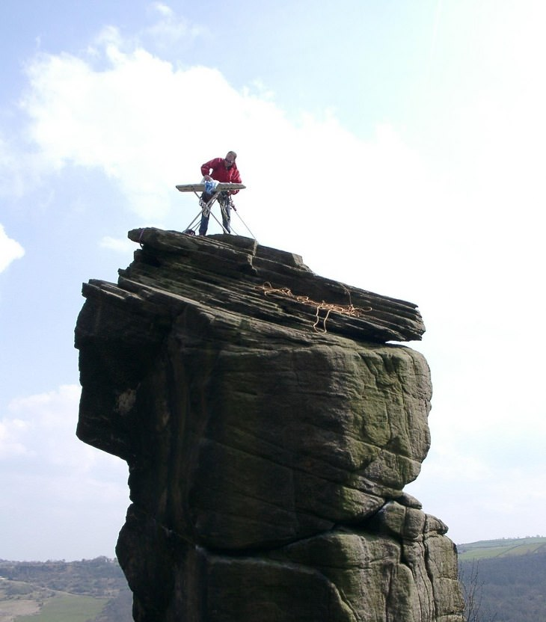
12. Extreme Ironing
Here's one that's absolutely nuts! Extreme ironing is a type of extreme sport where people take clothes and ironing boards to remote or dangerous locations to do a spot of ironing. According to the Extreme Ironing Bureau, extreme ironing is "the latest danger sport that combines the thrills of an extreme outdoor activity with the satisfaction of a well-pressed shirt."

Slide 16
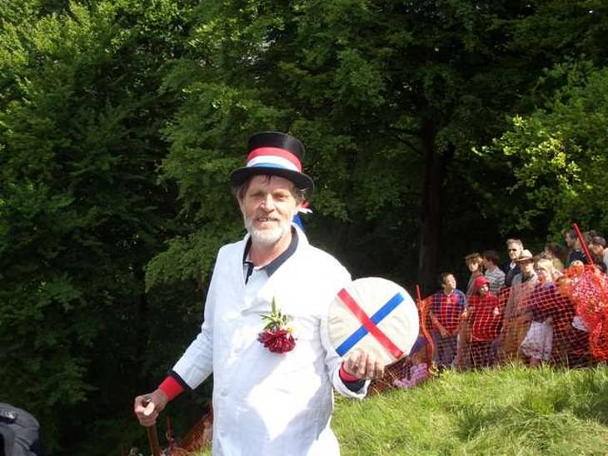
13. Cheese Rolling
A yearly event that takes place in Gloucester, England it the Cooper’s Hill Cheese-Rolling & Wake. This event involves participants rolling a 9-pound cheese wheel down an incredibly steep hill, and chasing after it. The first person to reach the bottom (in one piece) actually gets to take the cheese wheel home!

Slide 17
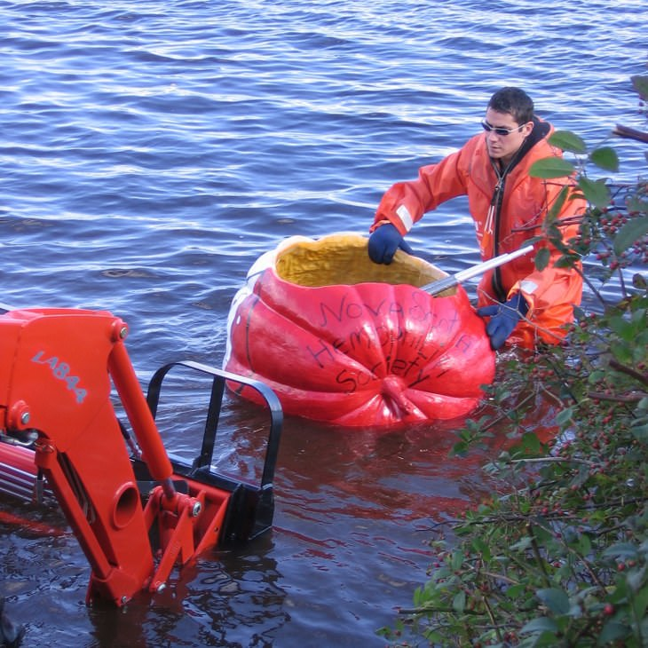
14. Giant Pumpkin Kayaking
If you're tired of using a kayak to go kayaking, then why not give this quirky sport a try instead? The most famous giant pumpkin race by far takes place annually on Nova Scotia's Lake Pesaquid. The race is around half a mile long, and participants typically decorate their pumpkins in a colorful way.

Slide 18
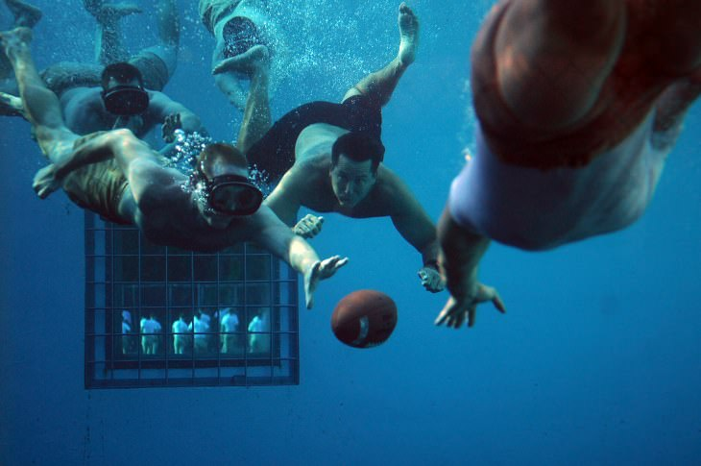
15. Underwater Football
Underwater football is basically American football that's usually played in a swimming pool. Players have to wear snorkeling equipment and are tasked with getting the weighted football to the gutter on the other side of the pool. It is played in Canada.

Slide 19
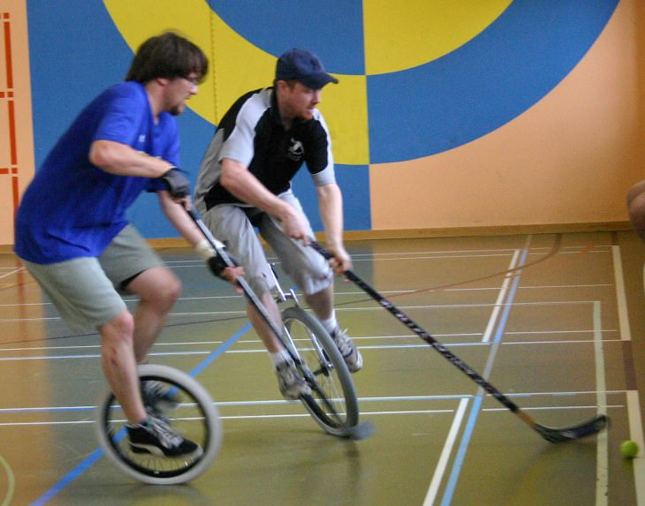
16. Unicycle Hockey
This one's almost as self-explanatory as underwater football, since unicycle hockey is pretty much nothing more than hockey on unicycles, as insane and dangerous as that may sound. Each team consists of 5 players who are required to have both feet on their unicycle at all times. There are 3 national leagues – UK, Germany and Switzerland.

Slide 20
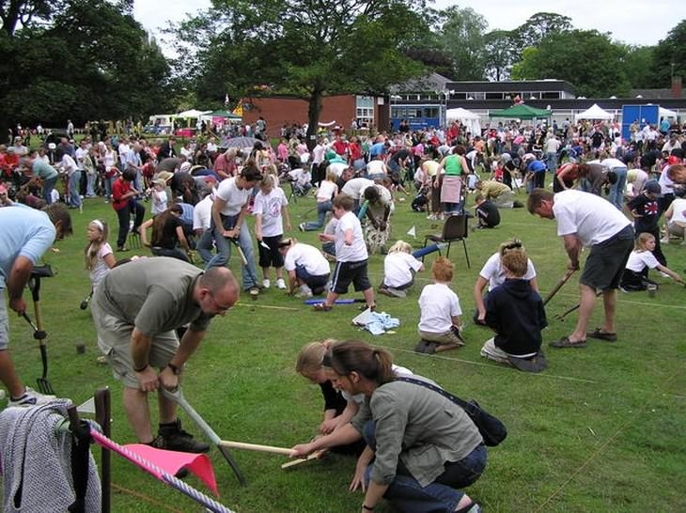
17. Competitive Worm Charming
Worm charming is a sport in which participants attempt to lure as many earthworms out of the ground as possible within a pre-defined timeframe. There are many kinds of techniques that can be used, however, the most common one is to simply tap the ground rhythmically until the worms begin to emerge. It is an annual event at Willaston County Primary School in Cheshire, England.

Slide 21
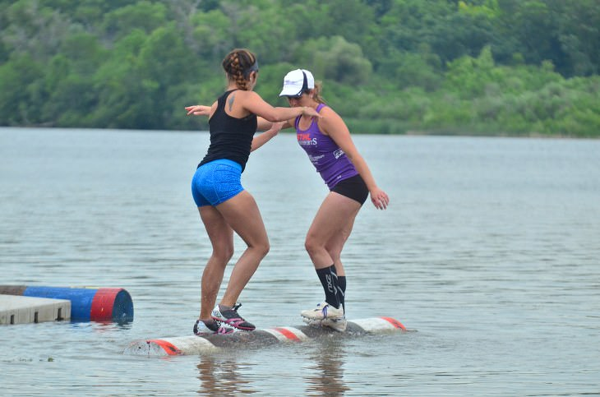
18. Log Rolling
Log rolling tournaments consist of two participants balancing on a floating log, while trying to push their opponent off, without crossing the centerline or making any physical contact. Participants typically win by repeatedly kicking the log, to make it bounce or change direction. It is most popular in the USA and Canada.

Slide 22
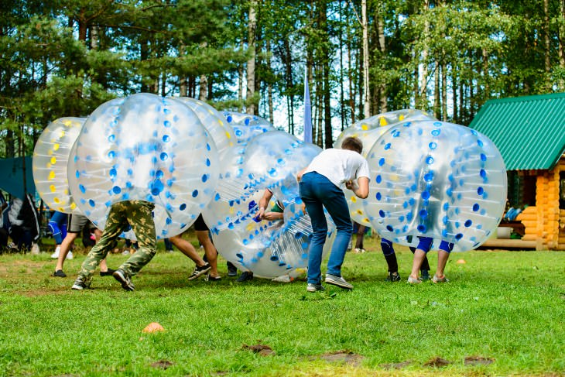
19. Bubble Soccer
In this quirky sport, players are strapped into huge inflatable bubbles, which cover their head and upper body. Each team typically consists of five players each, and the game is played with much of the same rules that soccer has. This sport is not only incredibly fun to play, but it's also absolutely hilarious to watch!
London held the first ever World Cup in May 2018, with the finals taking place at Wembley.

Slide 23
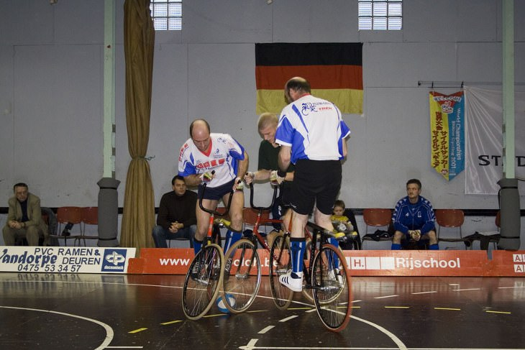
20. Cycleball
Also known as 'radball', this sport is essentially a game of soccer played with bicycles. The catch is that you're not allowed to use any part of your body, and must only touch the ball with your bicycle. The craziest part is that the bicycles used have absolutely no brakes installed!
It was first played in 1893 in Japan.
It is popular in Austria, Belgium, the Czech Republic, Denmark, France, Germany, Japan, Russia and Switzerland.

Slide 24
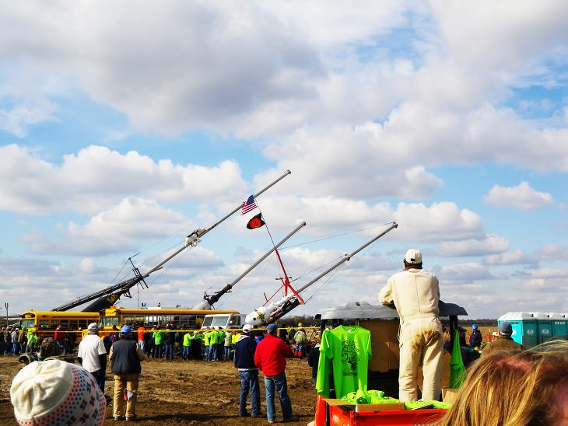
21. Pumpkin Chucking
Also known as 'punkin chunkin', this weird sport requires participants to hurl a pumpkin through the sky as far as possible using a homemade mechanical device. The devices created often vary greatly from one participant to the next, and include gigantic catapults, slingshots, trebuchets, bolt throwers, pneumatic cannons, and centrifugals.
It is popular in the USA.

Slide 25
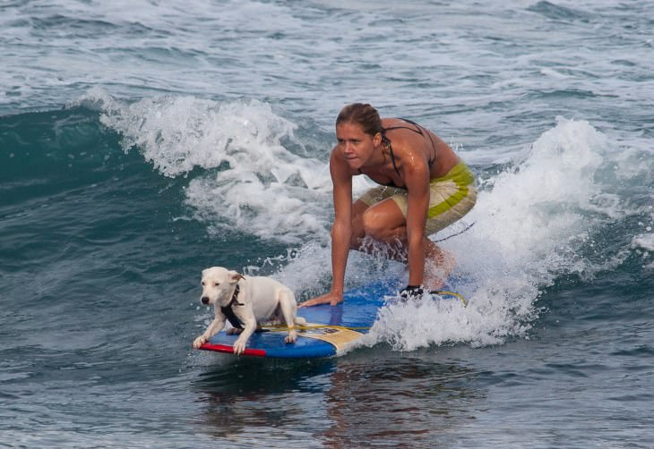
22. Dog Surfing
This one should be pretty self-explanatory, since it merely involves dogs riding the waves on surfboards, whether alone or accompanied by a human. It originated in California in the 1920s, and competitions are now held all across the USA's coastal areas.

Slide 26
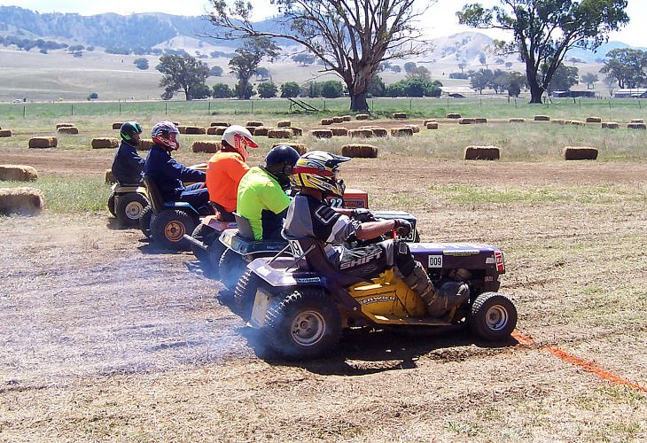
23. Lawnmower Racing
Invented in England's West Sussex in 1968 by a group of motoring enthusiasts who couldn't afford racecars, this weird sport puts a new spin on doing a spot of gardening. Usually, each lawnmower's blades are removed due to safety concerns, but the original mower engines are generally untouched.

Slide 27
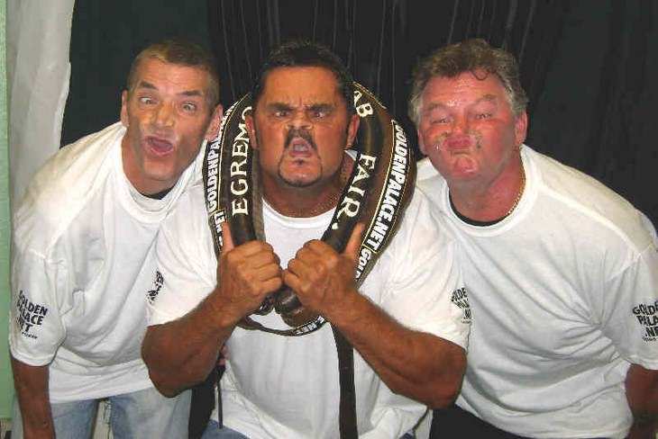
24. Gurning Contests
Gurning contests are a rural British tradition where participants compete to pull the most distorted facial expression possible. The World Gurning Championship takes place at the Egremont Crab Fair once a year, which dates back to 1267 when it was granted a Royal Charter by King Henry III.

Slide 28
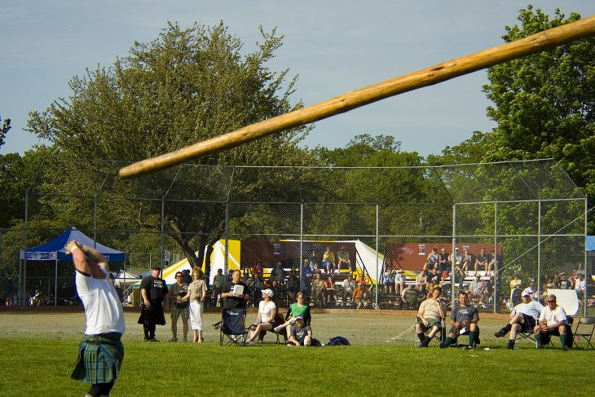
25. Caber Tossing
Caber tossing is a traditional Scottish game where people compete by tossing a heavy log, known as a caber (Gaelic for 'wooden beam'). However, the aim is not to toss it as far as possible but to vertically flip it over so that it lands in the '12 o'clock position' in reference to the thrower.

Slide 29
Additional research
If you have managed to plot the sports on a world map, can you find a sport that is popular in some of the countries that have not been mentioned in this Powerpoint?

