Slide 1
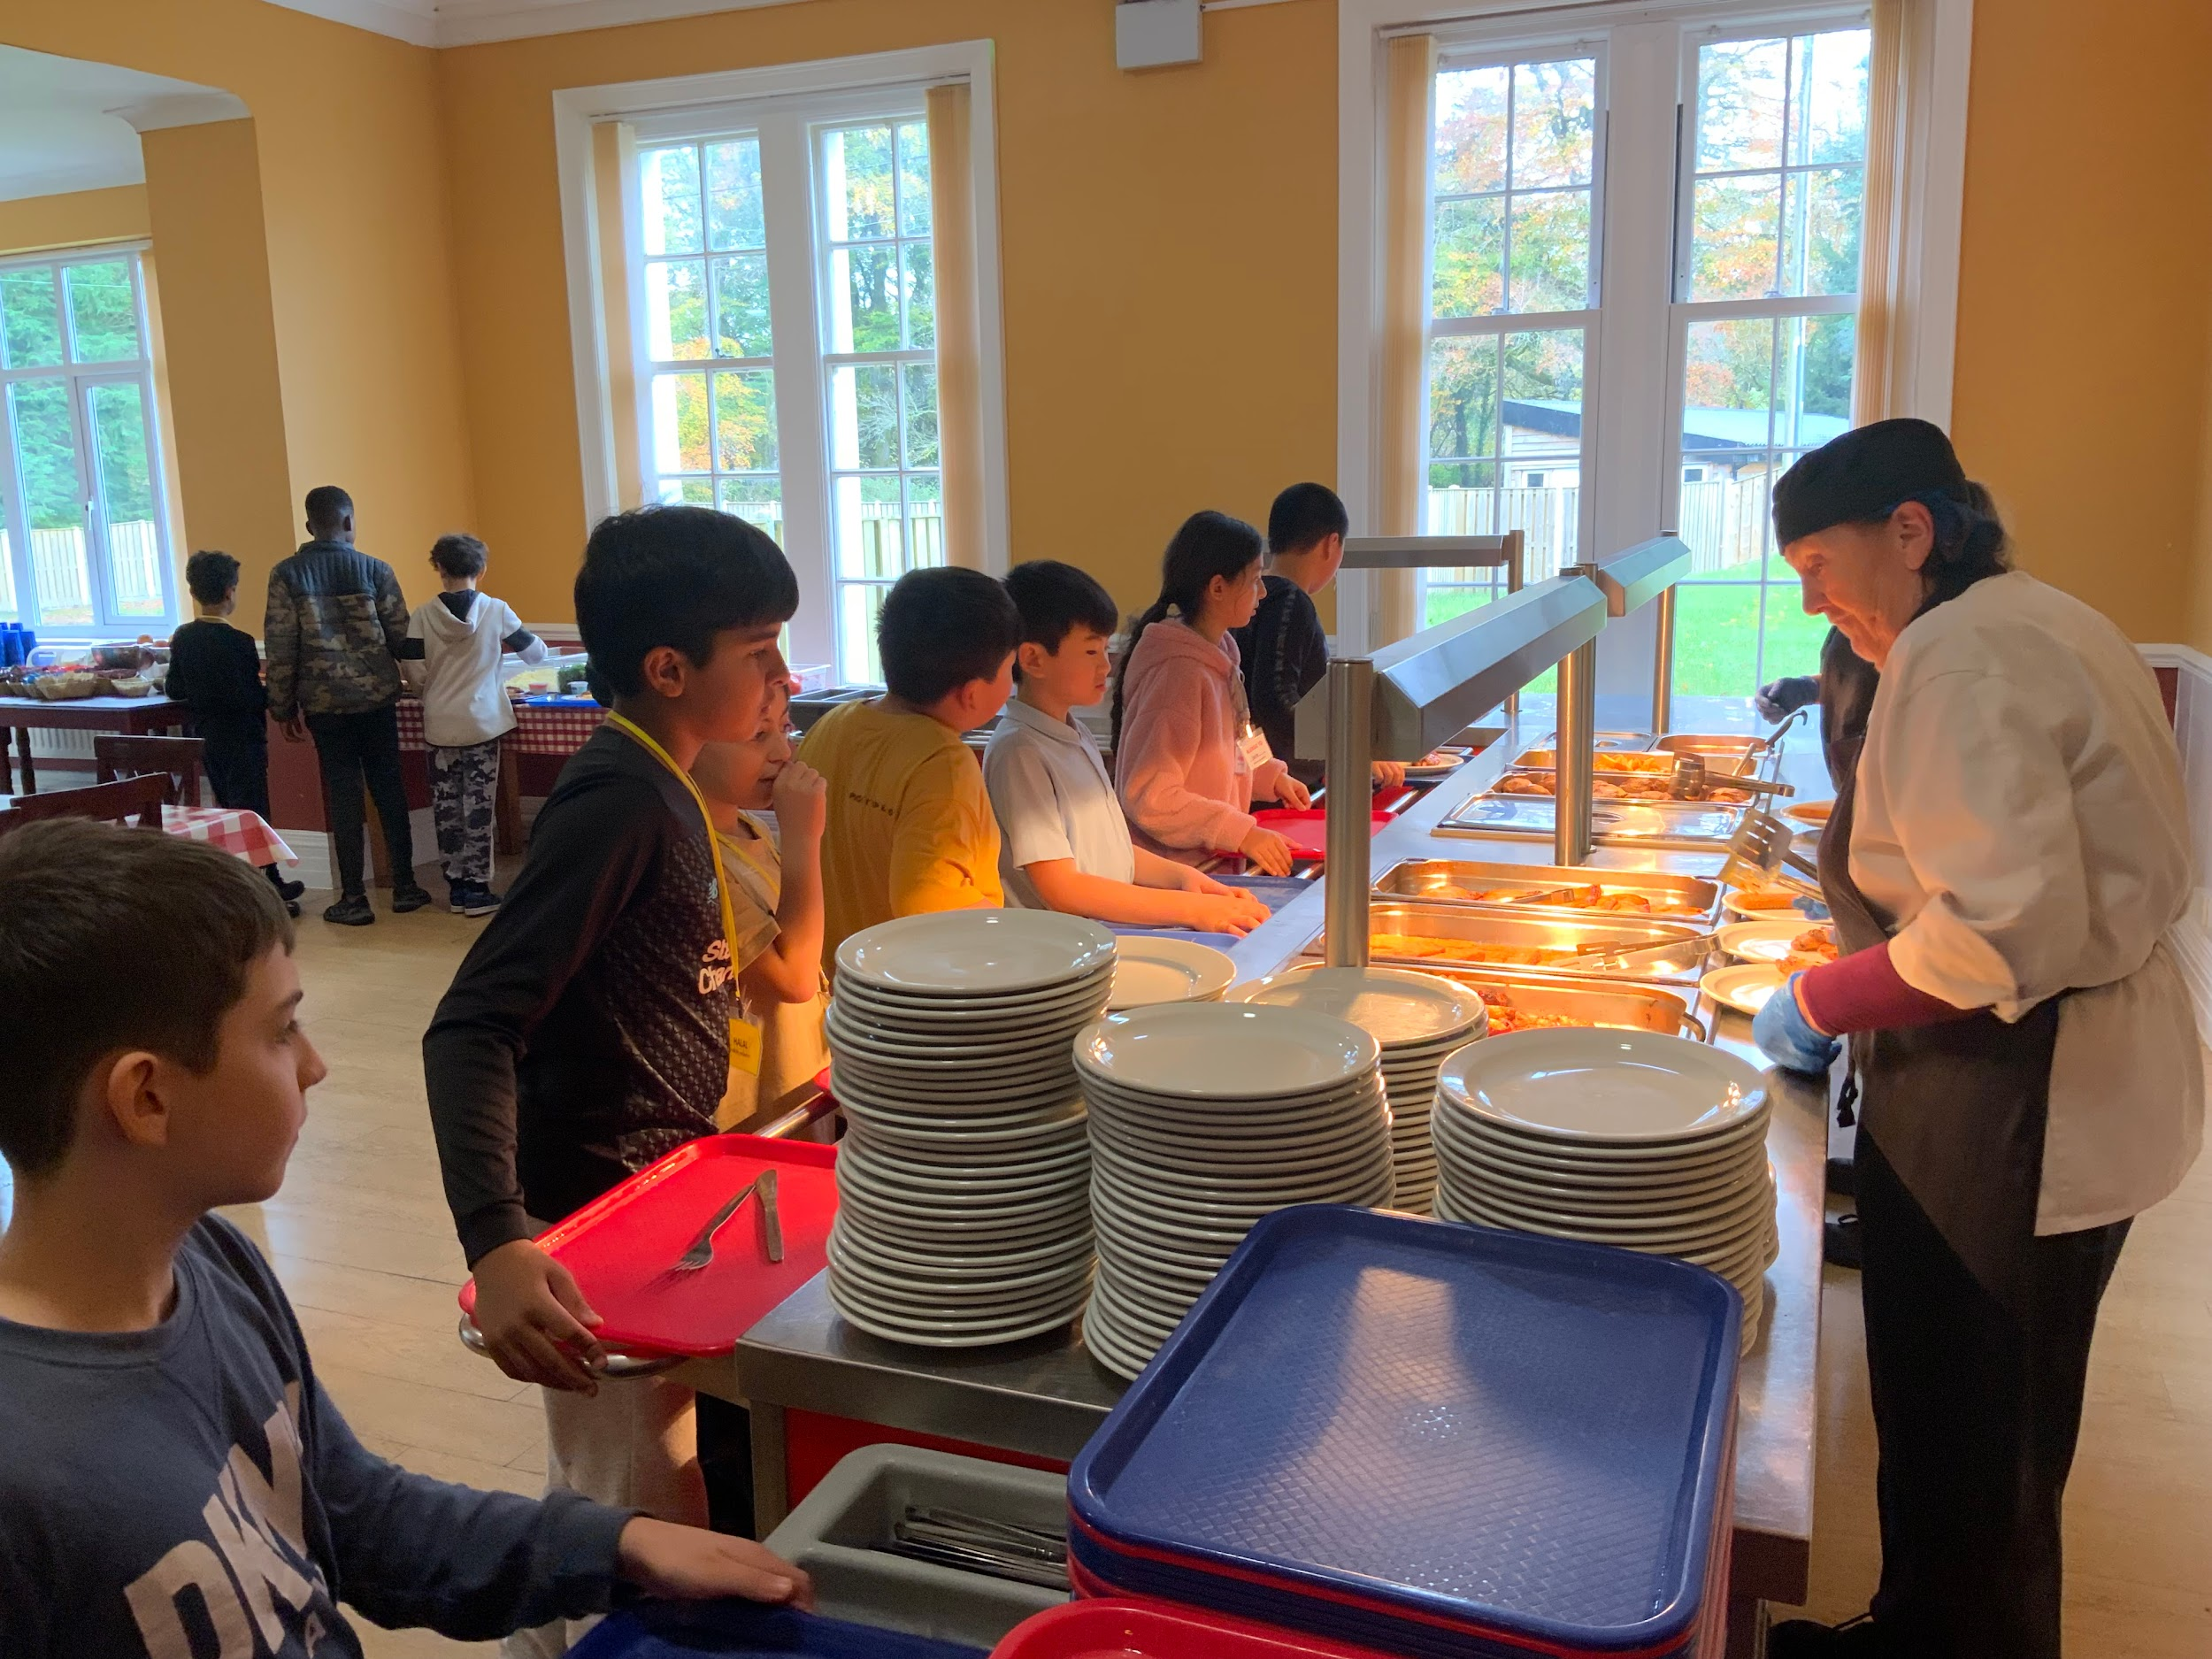
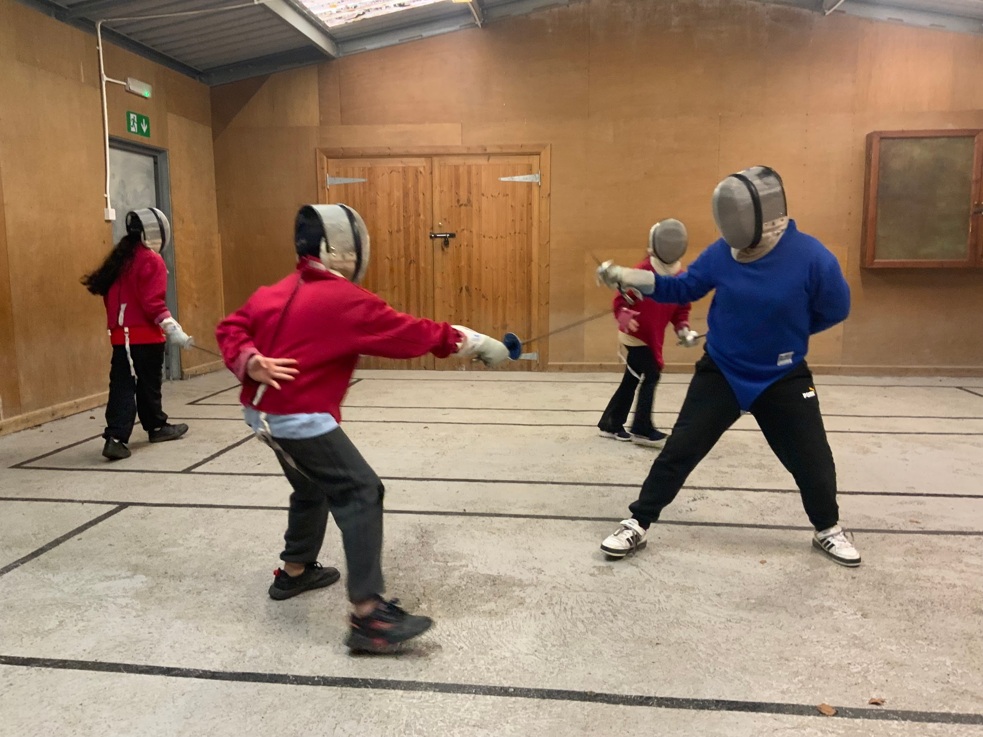

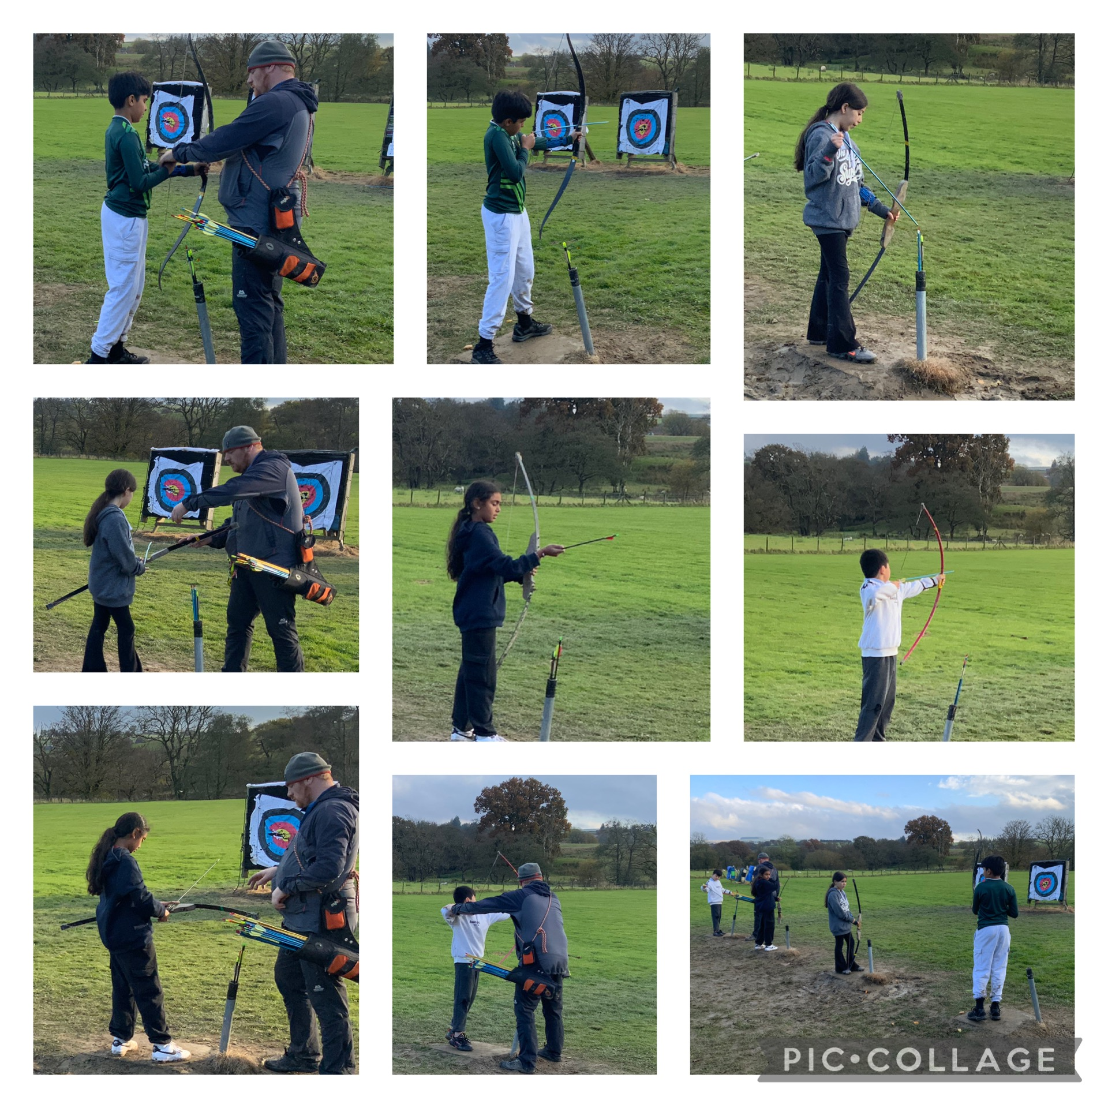
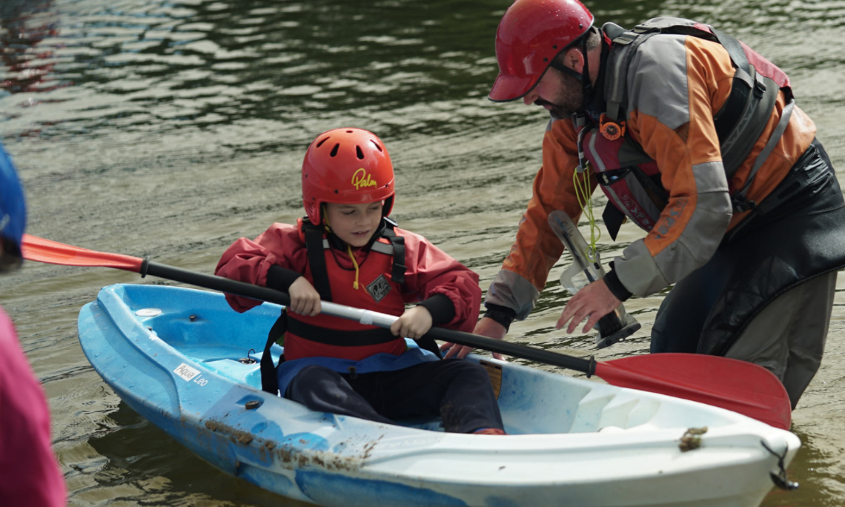
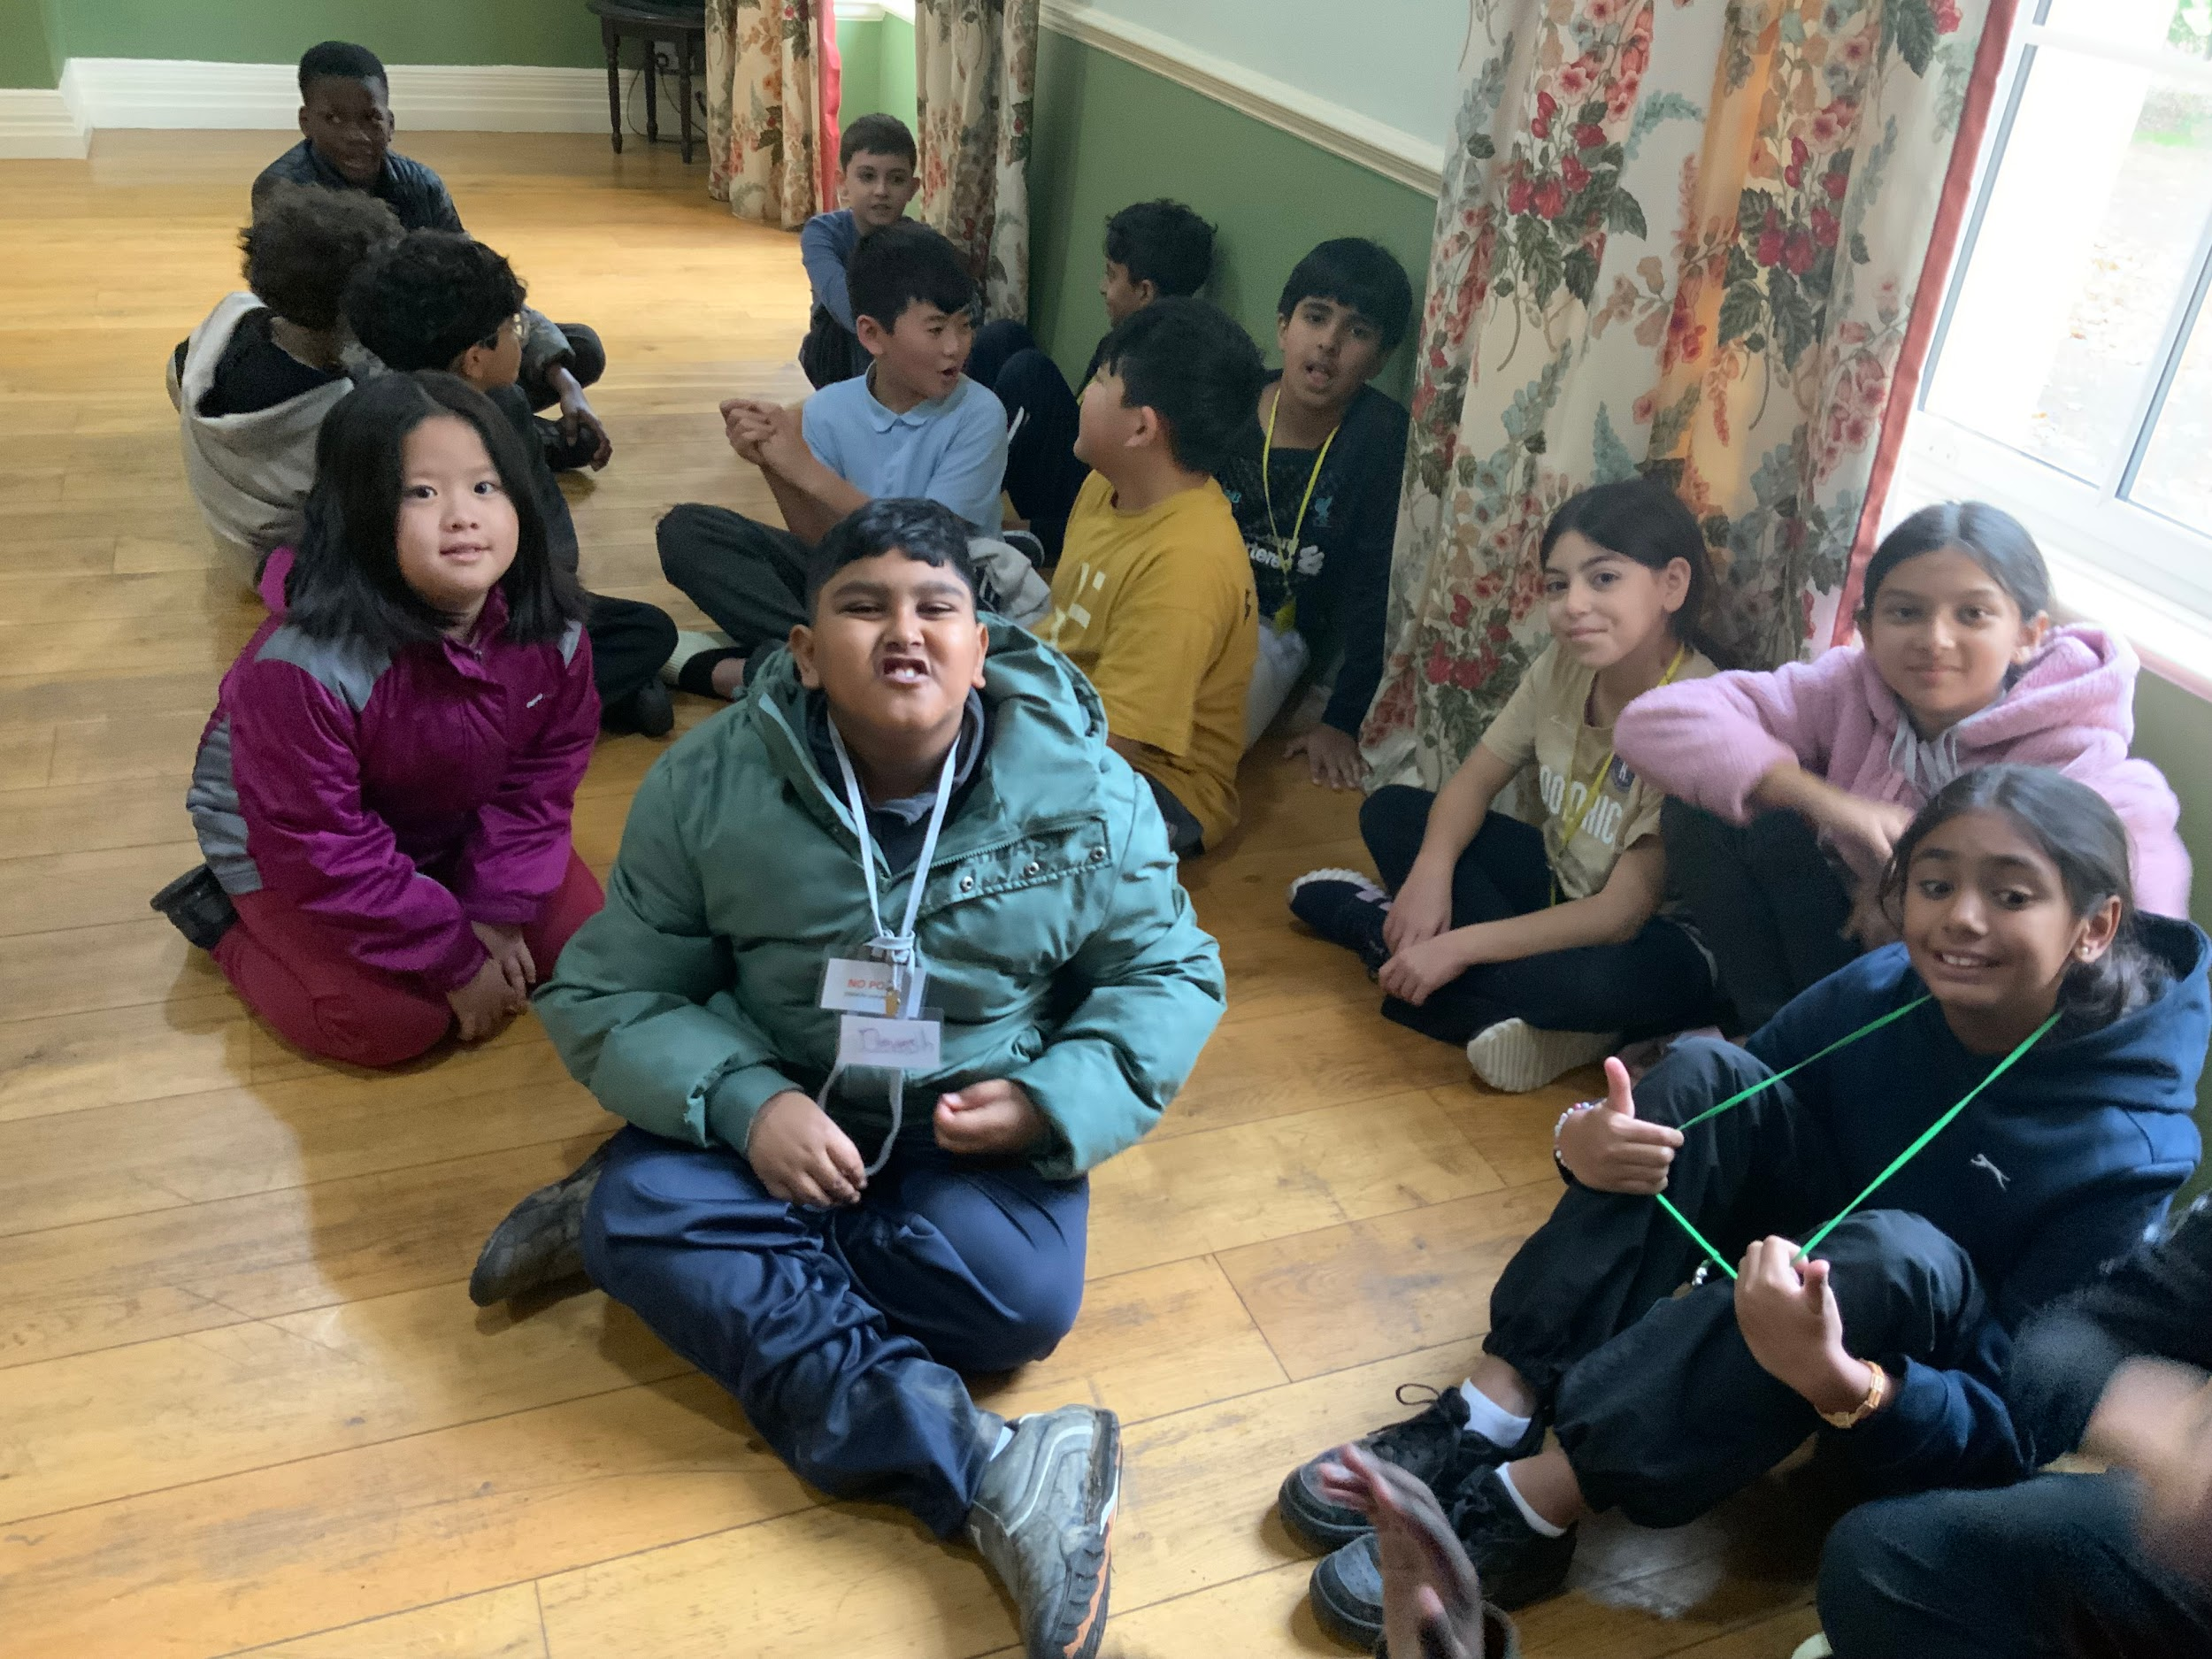
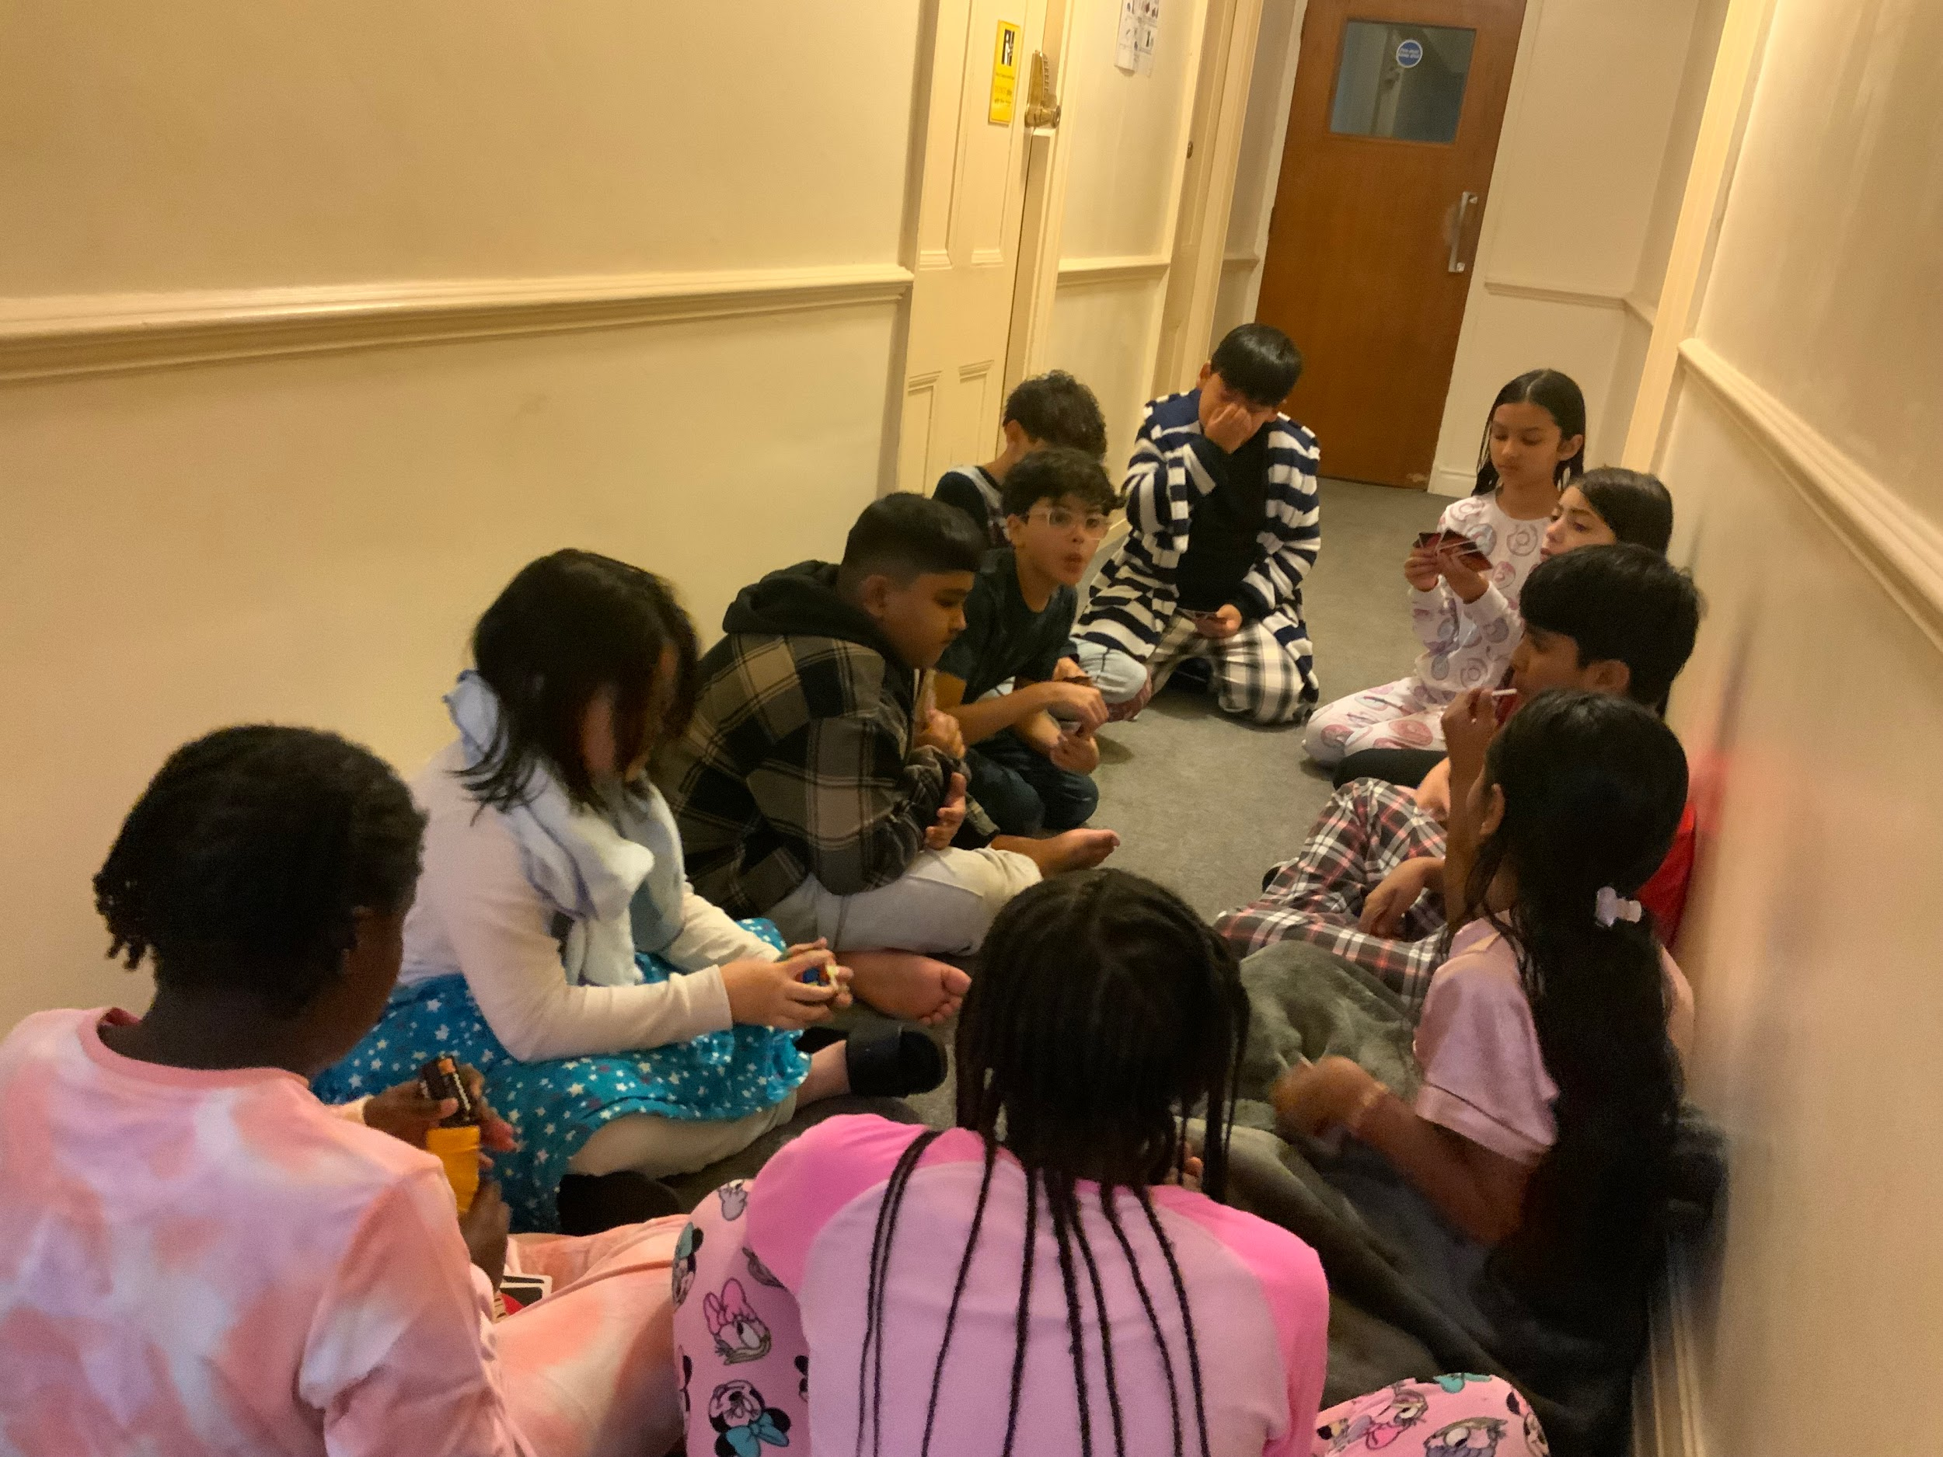
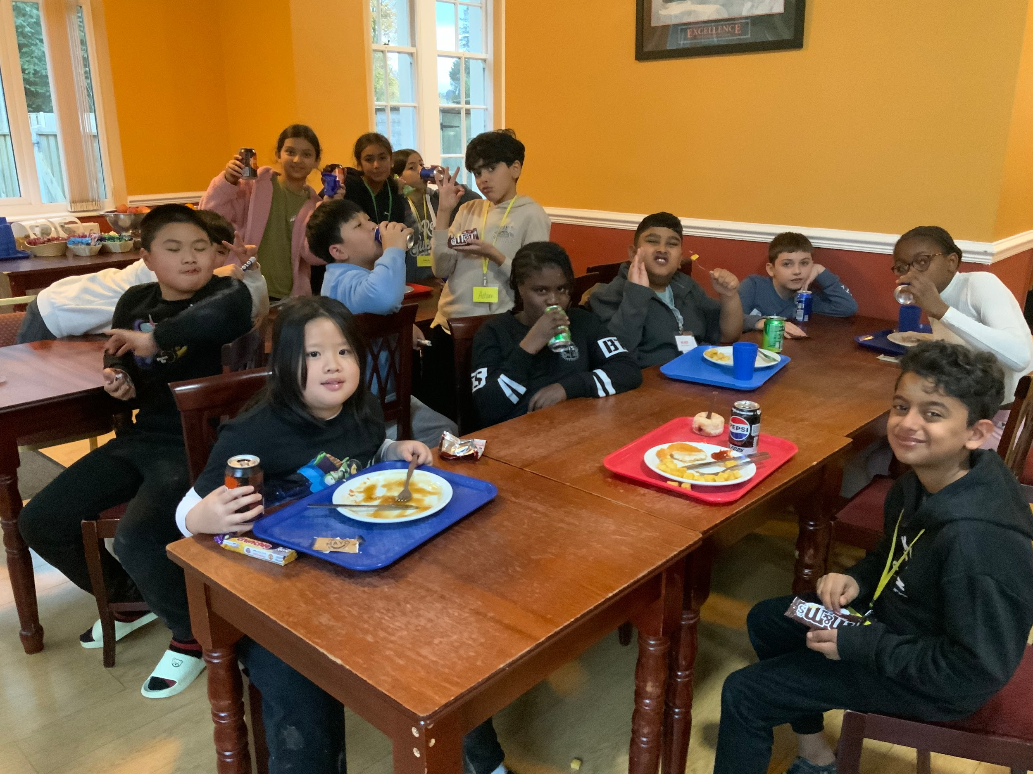
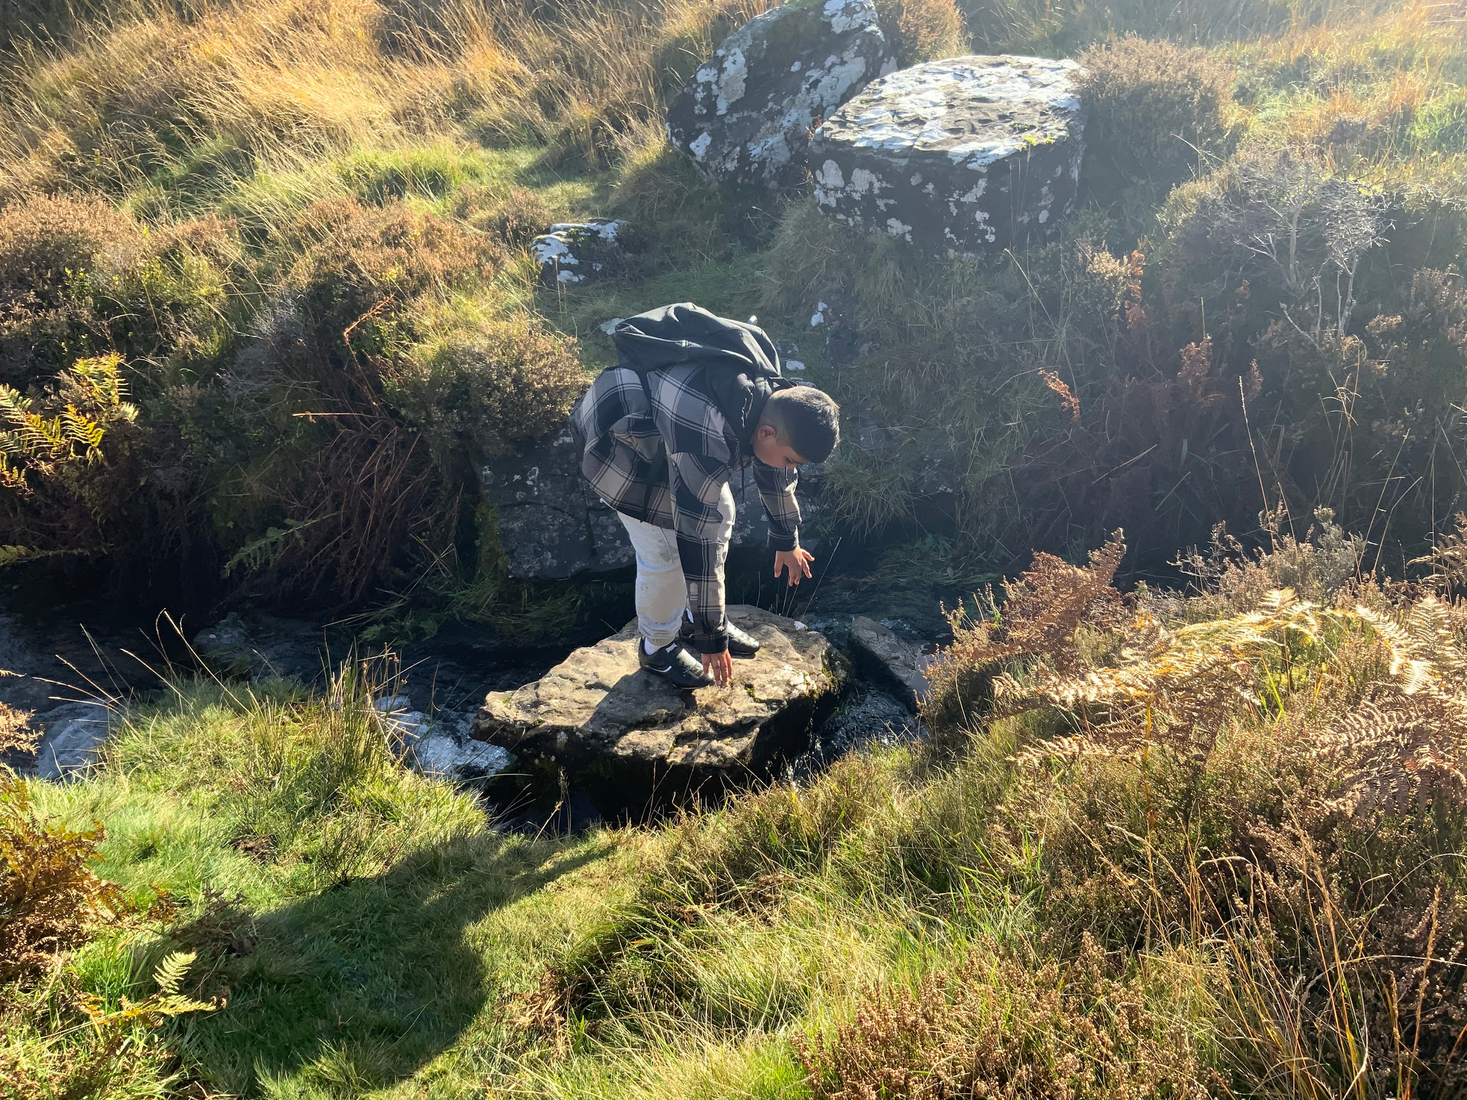
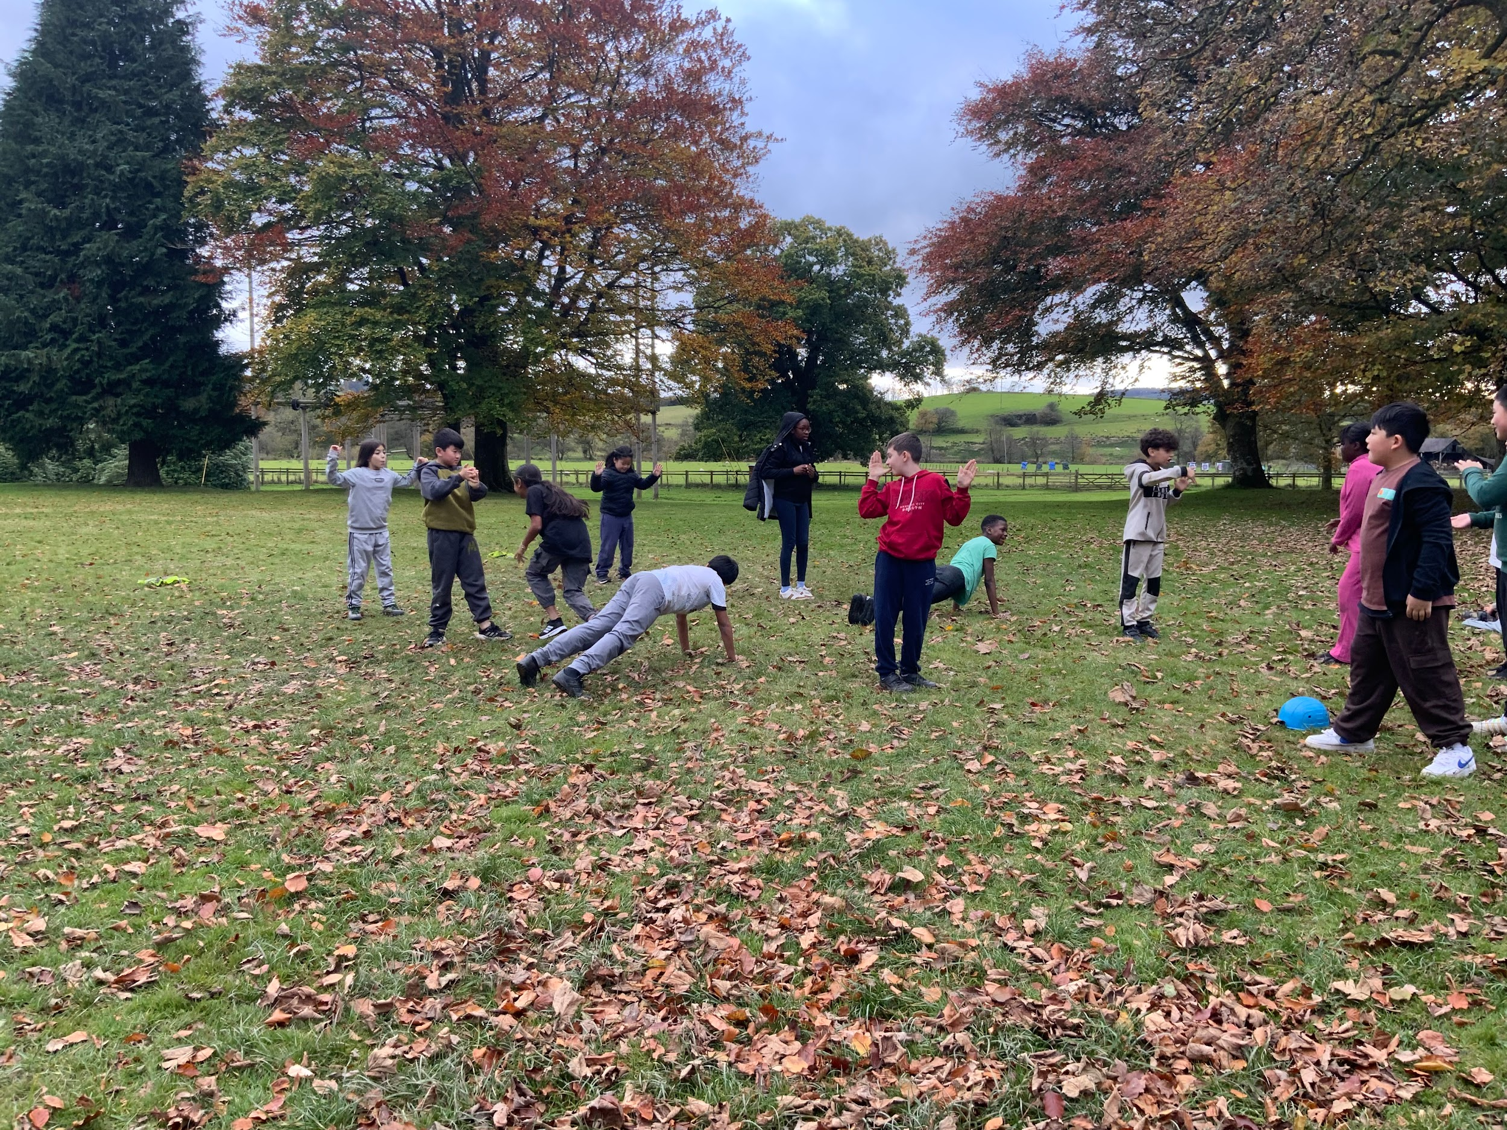
22nd-24th October 2025

Slide 2
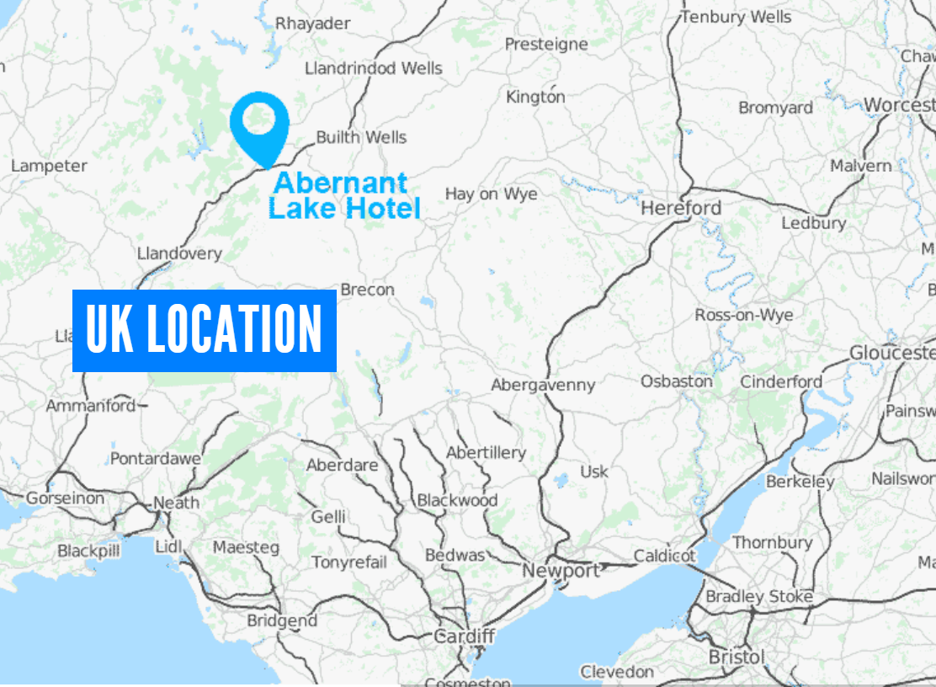
ABERNANT LAKE HOTEL,
LLANWRTYD WELLS,
POWYS
11Wednesday 22nd-Friday 24th October 2025
Located in Powys, Mid Wales.
We will leave from school on Wednesday morning in two mini-buses driven by Mrs Griffiths and Mrs Morris.
School staff staying are Mrs Griffiths and ———-
Activities are led by the staff from Manor Adventure, who are specifically trained in the activities along with first aid.
There is a first aider on site 24 hours a day (Health and Safety section of the website)

Slide 3
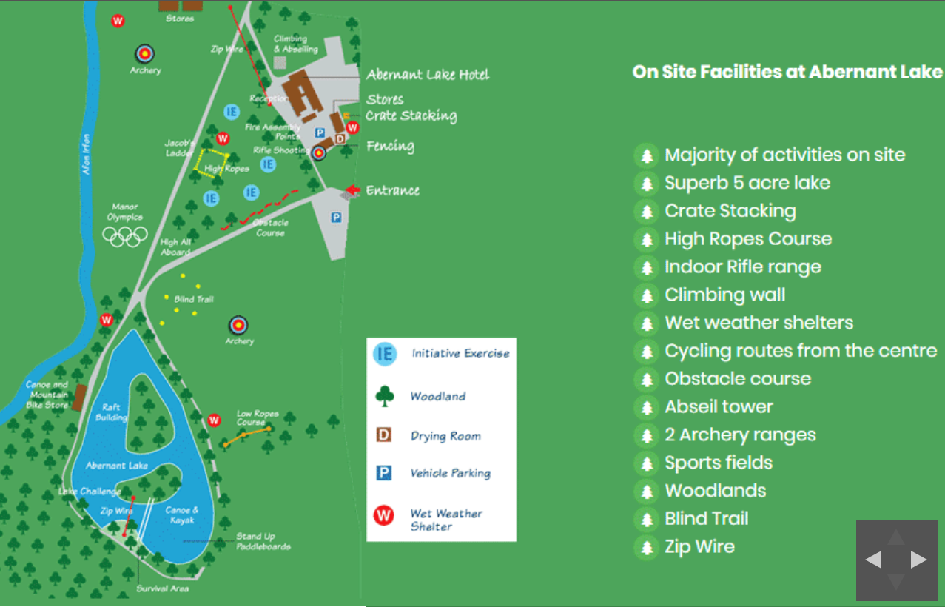

Slide 4
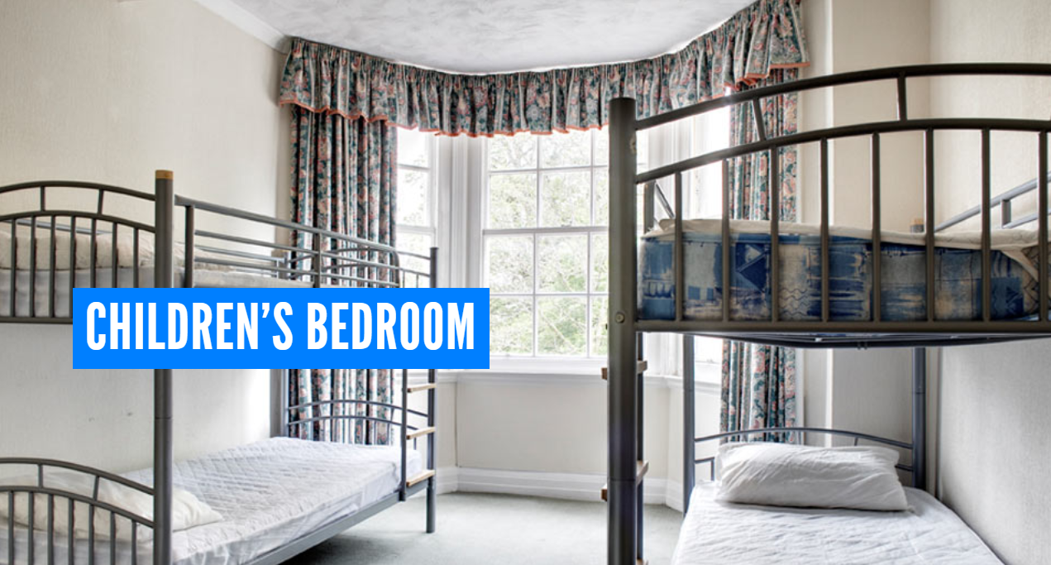
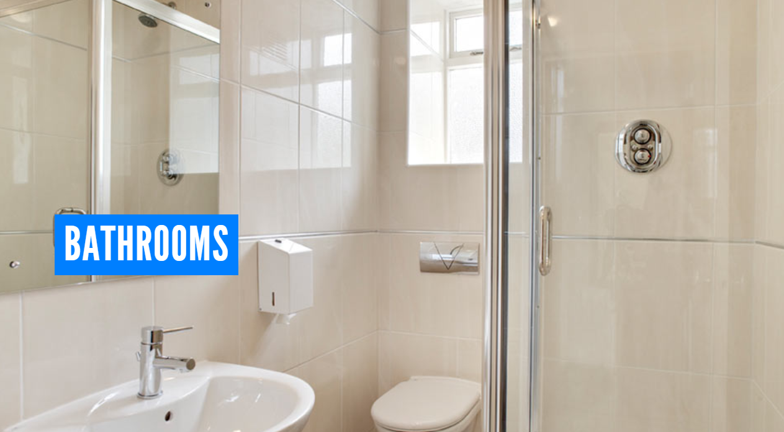
* 3- 6 children per room - children will share with at least 1 person they have asked to be with.
* Rooms have en-suite shower rooms with toilet and washbasin.
* Teachers bedrooms are adjacent to the children’s rooms.

Slide 5


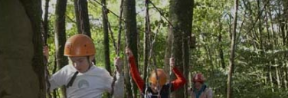
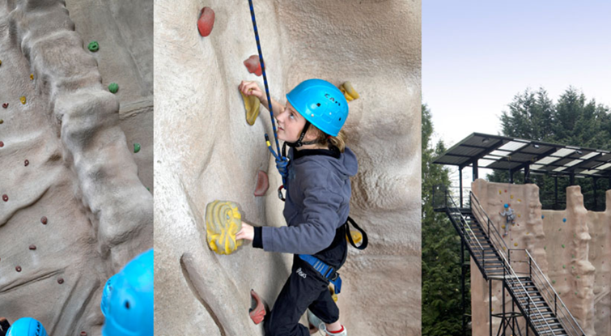
Activities
Children will be split into 2 groups one with Mrs Griffiths and one with the other Ninian adult going. They will complete the activities in these groups and we will all meet back together for meals.
Archery
Low Ropes
Climbing
Axe Throwing
Blind Trail
Kayaking/ Canoe
Low ropes
Manor Olympics
Fencing

Slide 6
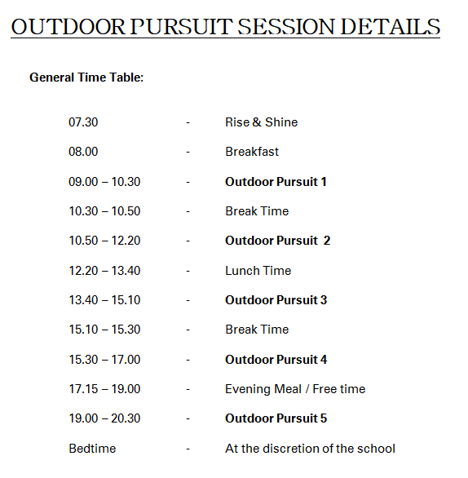

Slide 7

Dietary Requirements
Please make sure that we have the correct dietary requirements for your child.
For example; halal, vegetarian.
The children will be issued with a lanyard with a ticket on it so that it is clear to kitchen staff what each child is allowed to eat and it is also clearly labelled at the serving hatch. There is always a choice and plenty of fresh fruit is always on offer.

Slide 8
What to bring…
Luggage: Please restrict this to one small case plus one piece of hand luggage. These must have child’s name on.

Slide 9
What to bring…
Luggage: Please restrict this to one small case plus one piece of hand luggage. These must have child’s name on.
Bring a large carrier bag or bin bag for keeping damp and dirty clothing separate from the clean clothing.

Slide 10
What to bring…
Luggage: Please restrict this to one small case plus one piece of hand luggage. These must have child’s name on.
Bring a large carrier bag or bin bag for keeping damp and dirty clothing separate from the clean clothing.
Bedding: freshly laundered sleeping bags, pillow and pillowcase. Place bedding in a black bag or large shopping bag and label clearly with child’s name.

Slide 11
What to bring…
Luggage: Please restrict this to one small case plus one piece of hand luggage. These must have child’s name on.
Bring a large carrier bag or bin bag for keeping damp and dirty clothing separate from the clean clothing.
Bedding: freshly laundered sleeping bags, pillow and pillowcase. Place bedding in a black bag or large shopping bag and label clearly with child’s name.
Spending: This is not essential, but children may wish to have some money to spend on souvenirs i.e. postcards, sweets, water bottles and or drinks from our vending machines. Parents must provide coins not notes.
A maximum of £3 is allowed

Slide 12
What to bring…
Luggage: Please restrict this to one small case plus one piece of hand luggage. These must have child’s name on.
Bring a large carrier bag or bin bag for keeping damp and dirty clothing separate from the clean clothing.
Bedding: freshly laundered sleeping bags, pillow and pillowcase. Place bedding in a black bag or large shopping bag and label clearly with child’s name.
Spending: This is not essential, but children may wish to have some money to spend on souvenirs i.e. postcards, sweets, water bottles and or drinks from our vending machines. Parents must provide coins not notes.
A maximum of £3 is allowed
Money to be put in a labelled purse/ wallet and given to teacher upon arrival in school on Friday morning.

Slide 13
What to bring…
Luggage: Please restrict this to one small case plus one piece of hand luggage. These must have child’s name on.
Bring a large carrier bag or bin bag for keeping damp and dirty clothing separate from the clean clothing.
Bedding: freshly laundered sleeping bags, pillow and pillowcase. Place bedding in a black bag or large shopping bag and label clearly with child’s name.
Spending: This is not essential, but children may wish to have some money to spend on souvenirs i.e. postcards, sweets, water bottles and or drinks from our vending machines. Parents must provide coins not notes.
A maximum of £3 is allowed
Money to be put in a labelled purse/ wallet and given to teacher upon arrival in school on Friday morning.
Drink Bottle: Personal use. Must be labelled clearly.

Slide 14
What to bring…
Luggage: Please restrict this to one small case plus one piece of hand luggage. These must have child’s name on.
Bring a large carrier bag or bin bag for keeping damp and dirty clothing separate from the clean clothing.
Bedding: freshly laundered sleeping bags, pillow and pillowcase. Place bedding in a black bag or large shopping bag and label clearly with child’s name.
Spending: This is not essential, but children may wish to have some money to spend on souvenirs i.e. postcards, sweets, water bottles and or drinks from our vending machines. Parents must provide coins not notes.
A maximum of £3 is allowed
Money to be put in a labelled purse/ wallet and given to teacher upon arrival in school on Friday morning.
Drink Bottle: Personal use. Must be labelled clearly.
Put your child’s name on everything! You can order stickers, sew in tags or write with a permanent marker on the washing label.

Slide 15
Clothing - general guidelines
When packing clothing assume that your child will get wet or muddy on each activity.
Sports style clothing is best because it stays light when wet, dries quickly and gives a free range of movement.
Old clothes and shoes that you don’t mind getting ruined are essential.
Lots of thin layers are better than a thick coat worn over a t shirt.
Pack more socks and pants than you think necessary! A pair for each activity and a spare each day.
After the last activity we will wash and put night clothes on so no evening outfits are needed.

Slide 16

Clothing: Wednesday (2 activities), Thursday (4 activities), Friday (2 activities)
Come to school wearing comfortable travelling clothes.
Long sleeved tops x3
Jumper x 3
T shirts x4
Tracksuit bottoms/ leggings x4
Bathers to wear under clothes for canoeing and kayaking.
2x towels for drying hands and for showering.
2x or 3x trainers (so that there is always a dry pair available)
Night clothes such as pyjamas and slippers or indoor shoes to wear around the centre
Underwear – vest, pants and socks (2 sets per day)
Waterproof jacket
Toiletries- hand soap, body soap, shampoo, shower gel, toothbrush and toothpaste
A refillable water bottle to take to activities
Plastic bag for damp clothes/ towels
Clothing should be old or clothes you do not mind getting muddy and are easy/ comfortable to wear doing activities.
ALL clothing must be labelled

Slide 17
What won’t be needed:
Phones / ipods / ipads or other devices.
Aerosol sprays
Cameras or games
Electronics
More than £3
Junk food or extra snacks.

Slide 18
Medical Requirements
Forms must be completed and handed back into school asap.
All medicines must be clearly labelled with the dose and frequency of the dose written on the medicine.
All medicines to be placed in a clear bag which is also labelled.
Travel Tablets: As we departing after 10am we will give any child who needs it their travel tablet in school. If your child requires travel tablets please state this on the medical form. You will need to supply a tablet for the return journey.
Medicine will be administered by a teacher and will be witnessed by another teacher.

Slide 19
Come to school on Wednesday dressed in the clothes you will be wearing to Manor Adventure (i.e. non uniform)
Remember to bring enough clothes for all the activities.
Remember a sleeping bag, pillow and pillow case.
Remember your toothbrush and toothpaste.
The school website will be used to share information about the adventures with you whilst we are away.
We are scheduled to return on Friday 24th October at approximately 4:00pm.
If there are delays or changes to the return journey we will update you via our texts to parents.

